Slide 1
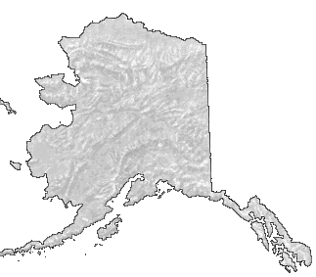


Effectively Working Cross-Culturally
presented at the
Moolin 2018 Seminars
Anchorage & Fairbanks
by Bob Tsigonis, P.E.
Fairbanks, Alaska

Slide 2
Premise
The best engineering and architectural designs combined with excellent construction practices can still result in complete project failure if your team lacks cross-cultural skills.

Slide 3
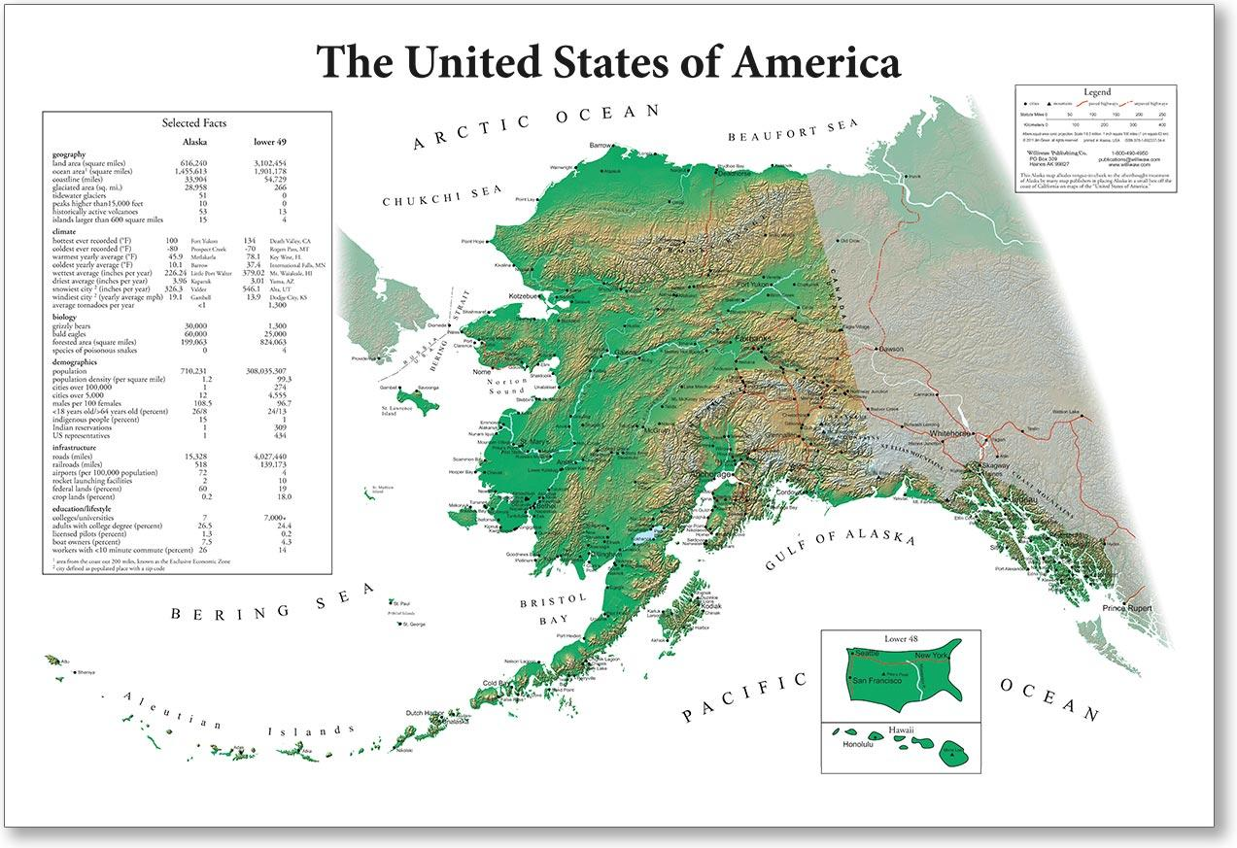
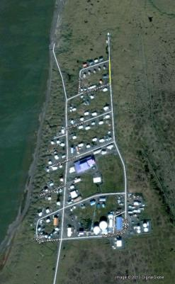
Point Lay, AK
Water & sewer loops are buried under the roads
Map available from www.williwaw.com

Slide 4
Background
Barrow (Utquiagvik) has mostly underground utilities; Pt. Lay residents wanted the same
Engineers recommended above ground lines
The people said, “No!”
Engineers couldn’t convince them
Acquiesced
Due to inability to work cross-culturally
Big mistake!

Slide 5
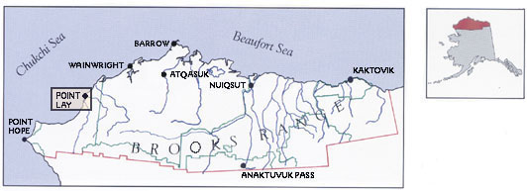
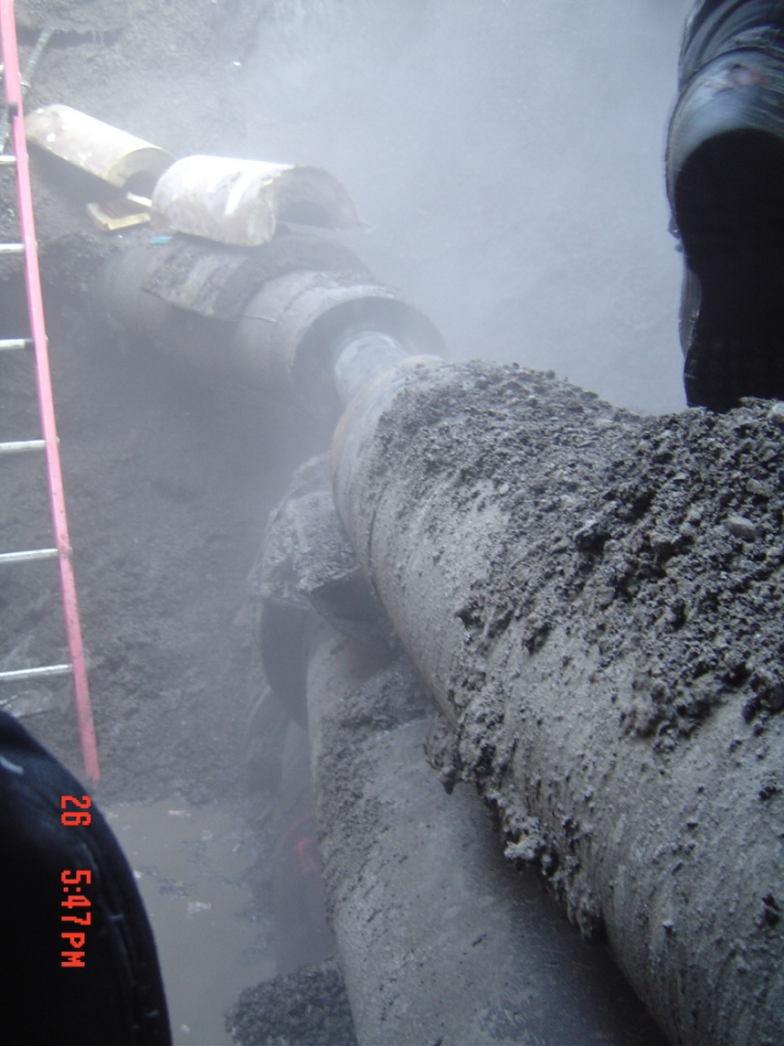
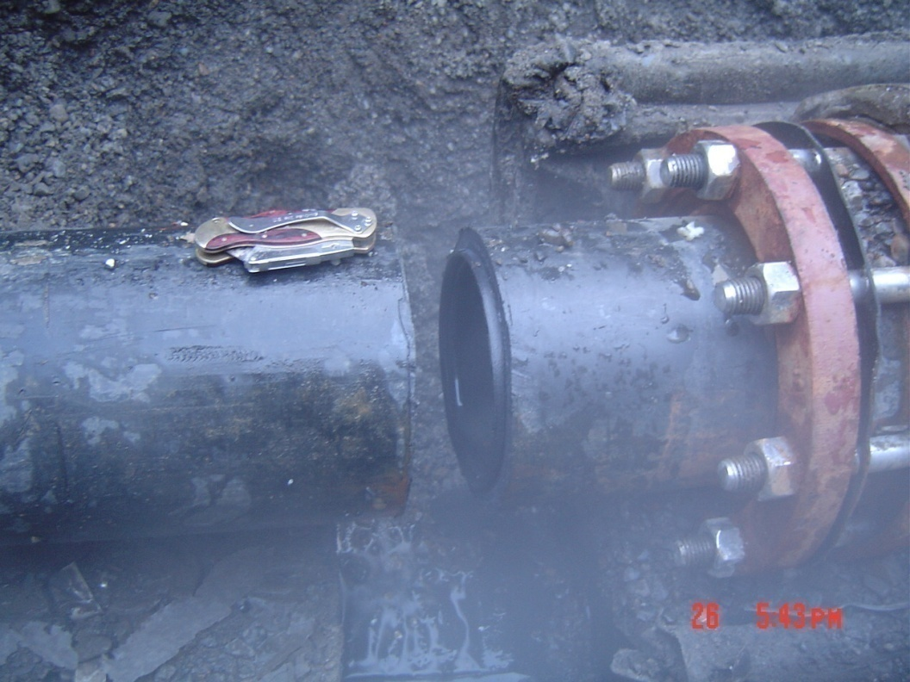
Commissioned in 2000
Explain symptoms – soft, wet roads during the late winter, vehicles getting stuck, water level in storage tank dropping rapidly.
Possibly move photos to later in the presentation.
Leaks began in 2004-2005

Slide 6
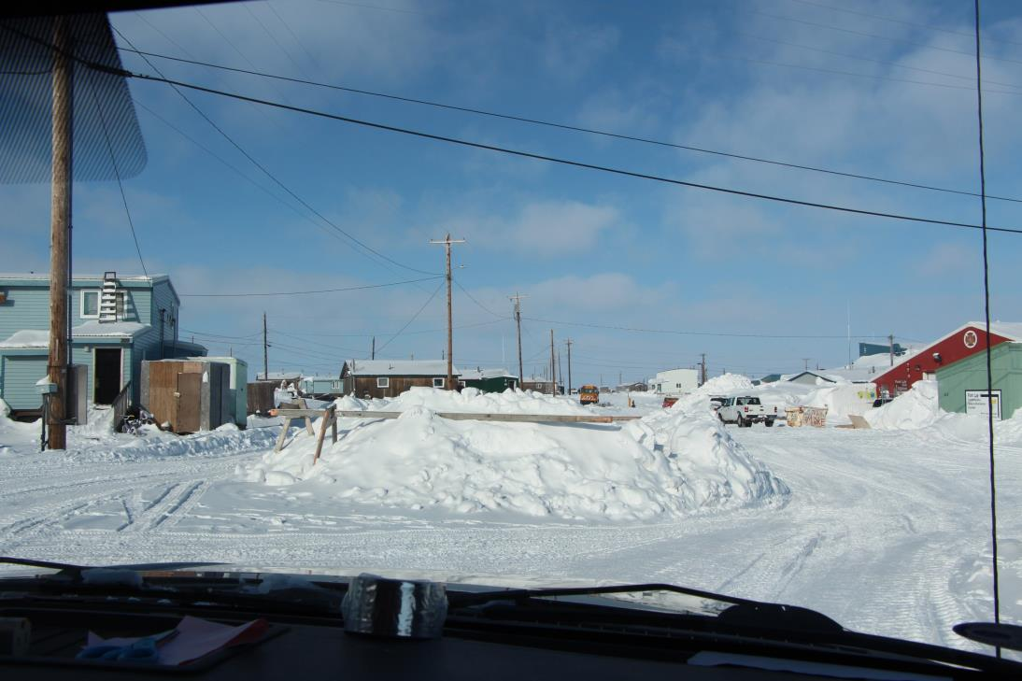
March 27, 2013
Excavation at every intersection
to access water and sewer lines

Slide 7
Now the people say,
  “How did those dumb engineers ever think buried pipes would work in our village?!”

Slide 8
The engineers knew what to do,
they simply could not do it
because they did not know how to
work cross-culturally.
Rather than the engineers guiding the residents into making right decisions,
the residents convinced the engineers
to make wrong decisions.
Use your cross-cultural skills from before the beginning of the project…
so you can do what needs to be done!!!

Slide 9

The problems persist…

Slide 10
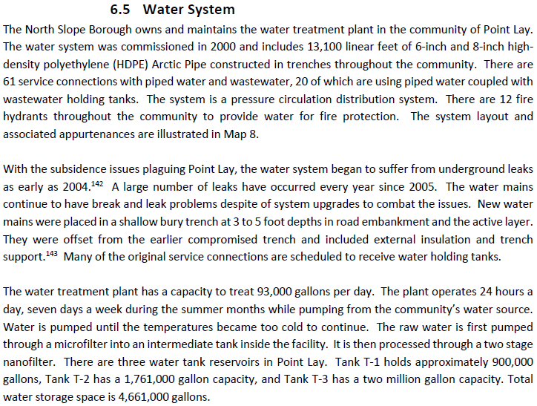

Slide 11
Working Cross-Culturally
Requires:
Flexibility
Compassion
Commitment
Interaction
Flexibility!
Wisdom
Persistence
Flexibility!

Slide 12
Working Cross-Culturally
Requires a paradigm shift, plus training and experience!
Requires:
Flexibility
Compassion
Commitment
Interaction
Flexibility!
Wisdom
Persistence
Flexibility!

Slide 13
The paradigm shift
Technological Focus
Sociological Focus
Equally important
Thought: “If we can overcome this, we are home free!”
Engineers and managers naturally focus here
Equally important
Reality: “If we neglect this, complete failure will be the result!”
Must be trained to focus here

Slide 14
Sociological focus is needed to achieve ‘ownership transfer’
Not a sales agreement or property title
Mental assent that this ______ is ours.
school
…clinic
…treatment plant
…generator
…wind turbine
…water/sewer system
…house

Slide 15
Ownership transfer is required to achieve success
We…
  requested it
  were involved in its selection, design, and construction
  understand how to operate and maintain it and accept responsibility to do so
  know that it costs money to operate and we will pay our share of the user fees

Slide 16
Ownership transfer is required to achieve success
So we must learn to
work cross-culturally
We…
  requested it
  were involved in its selection, design, and construction
  understand how to operate and maintain it and accept responsibility for doing so
  know that it costs money to operate it and will pay our share of the user fees

Slide 17
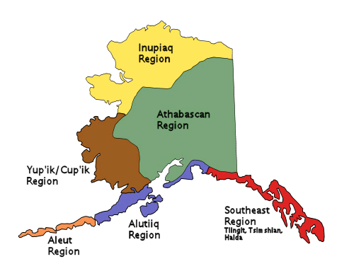
Alaska Native Cultural Regions

Slide 18
The following tables are excerpted from
Communication Across Cultures by Casie Williams, RN, BC, Med
Alaska Native Medical Center
Revised March 2002

Slide 19
MAINSTREAM AMERICAN CULTURAL VALUE | INUPIAT CULTURAL VALUE
Ownership | Sharing
Equality in social relationships | Respect for others
Competitiveness | Cooperation
 | Respect for elders
Love for children | Love for children
Achievement | Hard work
 | Knowledge of family tree
Directness in communication | Avoid conflict
Human superior to nature | Respect for nature
 | Spirituality
Humor | Humor
Nuclear family | Extended family
Material possessions | Hunter success
 | Domestic skills
Achievement-oriented | Humility
Individualism | Responsibility to tribe

Slide 20
NON-NATIVE BEHAVIOR | NATIVE BEHAVIOR
Early demonstration of learning, seeking to please | Early age – respect through silence & observation
Speaks to many people who give perspective to life; no need to talk to those he is close to | Converses at length with those he is close to; watches and gives respect to those he does not know well
Values conversation as a way to get to know others | Values observance as a way to get to know others
Learns through trial and error; teacher expects native students to demonstrate knowledge | Children listen and learn; don’t answer, question, or demonstrate skills unless they know the answer or are adept at the skill; unable to meet expectations of non-native teachers
“Puts best foot forward;” presents positive self-image and high hopes for the future; interprets native’s not boasting or speaking of future as lack of self-confidence | Not acceptable to “boast” or speak of the future (makes job interviews difficult)
Communicates rapidly | Thinks before answering; long pauses
Must have closure for courtesy | No closure; may hang up without saying good-bye
Direct messages | Indirect messages

Slide 21
NON-NATIVE BEHAVIOR | NATIVE BEHAVIOR
Early demonstration of learning, seeking to please | Early age – respect through silence & observation
Speaks to many people who give perspective to life; no need to talk to those he is close to | Converses at length with those he is close to; watches and gives respect to those he does not know well
Values conversation as a way to get to know others | Values observance as a way to get to know others
Learns through trial and error; teacher expects native students to demonstrate knowledge | Children listen and learn; don’t answer, question, or demonstrate skills unless they know the answer or are adept at the skill; unable to meet expectations of non-native teachers
“Puts best foot forward;” presents positive self-image and high hopes for the future; interprets native’s not boasting or speaking of future as lack of self-confidence | Not acceptable to “boast” or speak of the future (makes job interviews difficult)
Communicates rapidly | Thinks before answering; long pauses
Must have closure for courtesy | No closure; may hang up without saying good-bye
Direct messages | Indirect messages

Slide 22
NON-NATIVE BEHAVIOR | NATIVE BEHAVIOR
Early demonstration of learning, seeking to please | Early age – respect through silence & observation
Speaks to many people who give perspective to life; no need to talk to those he is close to | Converses at length with those he is close to; watches and gives respect to those he does not know well
Values conversation as a way to get to know others | Values observance as a way to get to know others
Learns through trial and error; teacher expects native students to demonstrate knowledge | Children listen and learn; don’t answer, question, or demonstrate skills unless they know the answer or are adept at the skill; unable to meet expectations of non-native teachers
“Puts best foot forward;” presents positive self-image and high hopes for the future; interprets native’s not boasting or speaking of future as lack of self-confidence | Not acceptable to “boast” or speak of the future (makes job interviews difficult)
Communicates rapidly | Thinks before answering; long pauses
Must have closure for courtesy | No closure; may hang up without saying good-bye
Direct messages | Indirect messages

Slide 23
NON-NATIVE BEHAVIOR | NATIVE BEHAVIOR
Early demonstration of learning, seeking to please | Early age – respect through silence & observation
Speaks to many people who give perspective to life; no need to talk to those he is close to | Converses at length with those he is close to; watches and gives respect to those he does not know well
Values conversation as a way to get to know others | Values observance as a way to get to know others
Learns through trial and error; teacher expects native students to demonstrate knowledge | Children listen and learn; don’t answer, question, or demonstrate skills unless they know the answer or are adept at the skill; unable to meet expectations of non-native teachers
“Puts best foot forward;” presents positive self-image and high hopes for the future; interprets native’s not boasting or speaking of future as lack of self-confidence | Not acceptable to “boast” or speak of the future (makes job interviews difficult)
Communicates rapidly | Thinks before answering; long pauses
Must have closure for courtesy | No closure; may hang up without saying good-bye
Direct messages | Indirect messages

Slide 24
NON-NATIVE BEHAVIOR | NATIVE BEHAVIOR
Early demonstration of learning, seeking to please | Early age – respect through silence & observation
Speaks to many people who give perspective to life; no need to talk to those he is close to | Converses at length with those he is close to; watches and gives respect to those he does not know well
Values conversation as a way to get to know others | Values observance as a way to get to know others
Learns through trial and error; teacher expects native students to demonstrate knowledge | Children listen and learn; don’t answer, question, or demonstrate skills unless they know the answer or are adept at the skill; unable to meet expectations of non-native teachers
“Puts best foot forward;” presents positive self-image and high hopes for the future; interprets native’s not boasting or speaking of future as lack of self-confidence | Not acceptable to “boast” or speak of the future (makes job interviews difficult)
Communicates rapidly | Thinks before answering; long pauses
Must have closure for courtesy | No closure; may hang up without saying good-bye
Direct messages | Indirect messages

Slide 25
ENGLISH SPEAKERS THINK… | ATHAPASKANS THINK…
Presentation of Self
They do not speak | They talk too much
They keep silent | They always talk first
They avoid situations of talking | They talk to people they do not know
They play down their abilities | They brag about themselves
They act as if they expect things to be given to them | They do not help people even when they can
They deny planning | They always talk about what is going to happen later
Distribution of Talk
They avoid direct questions | They ask too many questions
They never start a conversation | They always interrupt
They talk off the topic | They only talk about what they are interested in
They never say anything about themselves | They don’t give others a chance to talk
They are slow to take a turn in talking | They just go on and on when they talk

Slide 26
ENGLISH SPEAKERS THINK… | ATHAPASKANS THINK…
Presentation of Self
They do not speak | They talk too much
They keep silent | They always talk first
They avoid situations of talking | They talk to people they do not know
They play down their abilities | They brag about themselves
They act as if they expect things to be given to them | They do not help people even when they can
They deny planning | They always talk about what is going to happen later
Distribution of Talk
They avoid direct questions | They ask too many questions
They never start a conversation | They always interrupt
They talk off the topic | They only talk about what they are interested in
They never say anything about themselves | They don’t give others a chance to talk
They are slow to take a turn in talking | They just go on and on when they talk

Slide 27
ENGLISH SPEAKERS THINK… | ATHAPASKANS THINK…
Contents of Talk
They are too indirect, too explicit | They are not careful about how they talk about people or things
They don’t make sense
They just leave without saying anything | They have to say good-bye even when you are the one who is leaving
BODY LANGUAGE | MEANING TO NON-NATIVE | MEANING TO NATIVE
Nodding head | “I understand what you are saying” | “I hear what you are saying”
Raised eyebrows | “I am surprised by what I am seeing or hearing” | “Yes, I agree with what you are saying”
Furrowed brow | “I am listening very carefully to what you are saying” or “I question the truth in what I am seeing or hearing” | “No” or “I am displeased with you”
Tapping pencil | “I am distracted” | “I am bored”
Arms tight to body | “I am cold” | I want to maintain an impersonal distance to you
No eye contact | “I am lying to you” | “I respect you”

Slide 28
ENGLISH SPEAKERS THINK… | ATHAPASKANS THINK…
Contents of Talk
They are too indirect, too explicit | They are not careful about how they talk about people or things
They don’t make sense
They just leave without saying anything | They have to say good-bye even when you are the one who is leaving
BODY LANGUAGE | MEANING TO NON-NATIVE | MEANING TO NATIVE
Nodding head | “I understand what you are saying” | “I hear what you are saying”
Raised eyebrows | “I am surprised by what I am seeing or hearing” | “Yes, I agree with what you are saying”
Furrowed brow | “I am listening very carefully to what you are saying” or “I question the truth in what I am seeing or hearing” | “No” or “I am displeased with you”
Tapping pencil | “I am distracted” | “I am bored”
Arms tight to body | “I am cold” | I want to maintain an impersonal distance to you
No eye contact | “I am lying to you” | “I respect you”

Slide 29
ENGLISH SPEAKERS THINK… | ATHAPASKANS THINK…
Contents of Talk
They are too indirect, too explicit | They are not careful about how they talk about people or things
They don’t make sense
They just leave without saying anything | They have to say good-bye even when you are the one who is leaving
BODY LANGUAGE | MEANING TO NON-NATIVE | MEANING TO NATIVE
Nodding head | “I understand what you are saying” | “I hear what you are saying”
Raised eyebrows | “I am surprised by what I am seeing or hearing” | “Yes, I agree with what you are saying”
Furrowed brow | “I am listening very carefully to what you are saying” or “I question the truth in what I am seeing or hearing” | “No” or “I am displeased with you”
Tapping pencil | “I am distracted” | “I am bored”
Arms tight to body | “I am cold” | I want to maintain an impersonal distance to you
No eye contact | “I am lying to you” | “I respect you”

Slide 30
ENGLISH SPEAKERS THINK… | ATHAPASKANS THINK…
Contents of Talk
They are too indirect, too explicit | They are not careful about how they talk about people or things
They don’t make sense
They just leave without saying anything | They have to say good-bye even when you are the one who is leaving
BODY LANGUAGE | MEANING TO NON-NATIVE | MEANING TO NATIVE
Nodding head | “I understand what you are saying” | “I hear what you are saying”
Raised eyebrows | “I am surprised by what I am seeing or hearing” | “Yes, I agree with what you are saying”
Furrowed brow | “I am listening very carefully to what you are saying” or “I question the truth in what I am seeing or hearing” | “No” or “I am displeased with you”
Tapping pencil | “I am distracted” | “I am bored”
Arms tight to body | “I am cold” | I want to maintain an impersonal distance to you
No eye contact | “I am lying to you” | “I respect you”

Slide 31
Elders
Elders are highly respected
Considered wise by virtue of age and survival
Treat them with the utmost respect
Not doing so may cause offence and result in passive resistance to all you want to accomplish
Identify the chief, mayor, village elders/leaders
Contact them to honor them – even if you are not dealing directly with them
Gain their support

Slide 32
Community Gatherings
Will likely not start on time
Will never end on time
People will come for food – even potlatches
The more door prizes you have, the more people will attend
They appreciate you showing an interest in their culture
  Dance!
  Beat the drum!
  Eat their food (keep Ziplock in pocket)

Slide 33
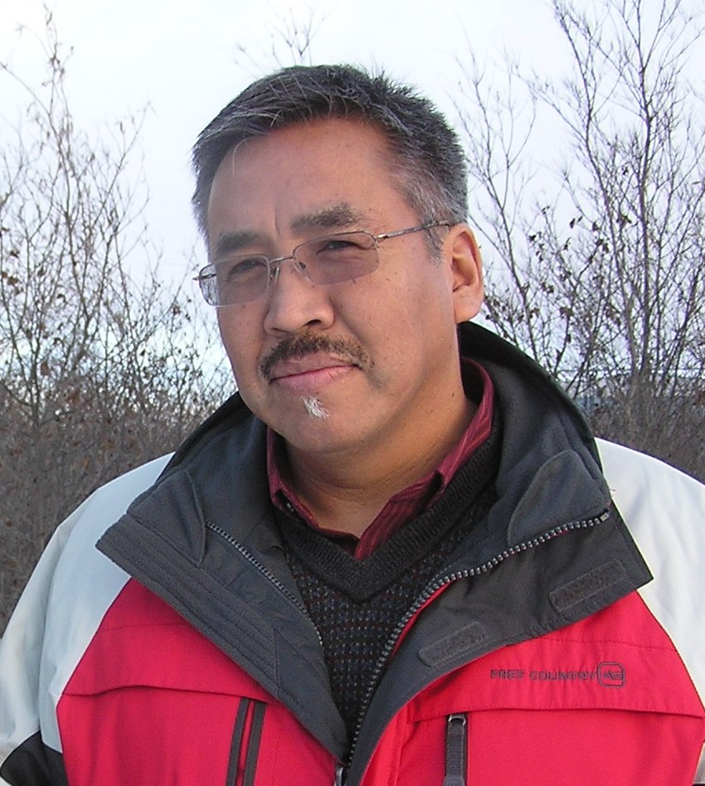
Community Gatherings
Priority of serving food
  Male elders
  Female elders
  Males
  Females
  Children feed themselves
Do not step over a backpack or personal item – do not move it – respect it

Slide 34
Public Introductions
They may introduce themselves by giving:
  Their non-native name
  Their native name and its meaning
  What village they are from
  A brief family history
  What brought them here for this gathering
It’s important for them know who you are and how you are connected to their village
Prepare your story before you get there!

Slide 35
Public Meetings
English may not be their first language
Speak slowly in short sentences with no extra words
Pause often
Do not ask many questions – respect their privacy
If they are not responding…
  They are trained to listen and watch
  They may be processing what you said – wait
  May have said “Yes” by raising their eyebrows or “No” by scrunching their eyebrows
  May use their nose to point
  They may not understand what you said – wait – then say it a different way

Slide 36
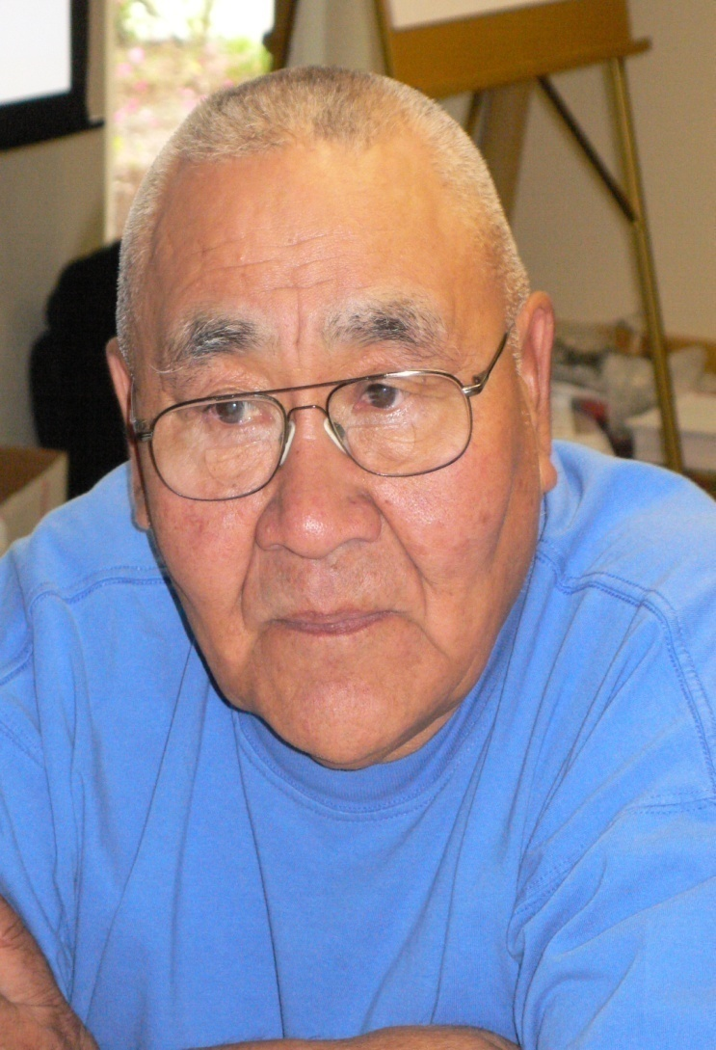
Public Meetings
They often look down and do not make eye contact
In a lecture setting they will not look at you or your mouth – they may appear to be sleeping (esp. men), but they will be listening!

Slide 37
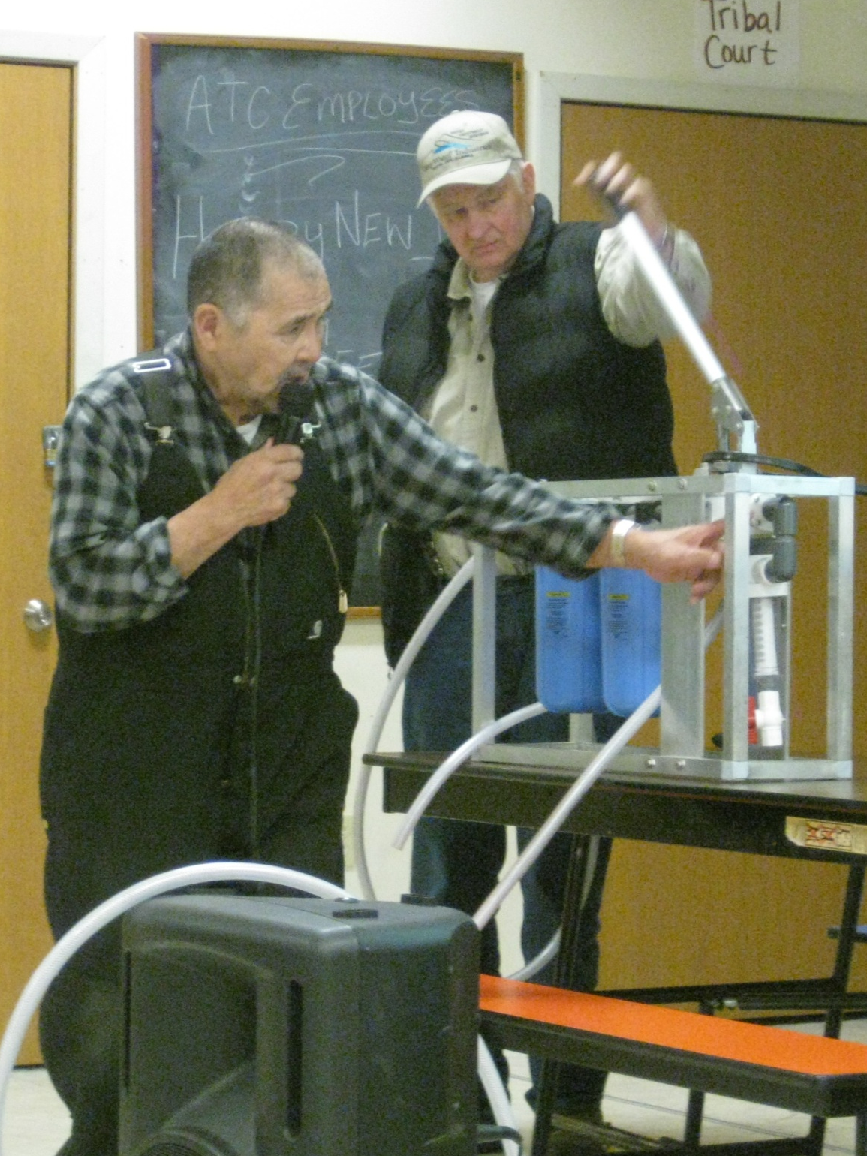
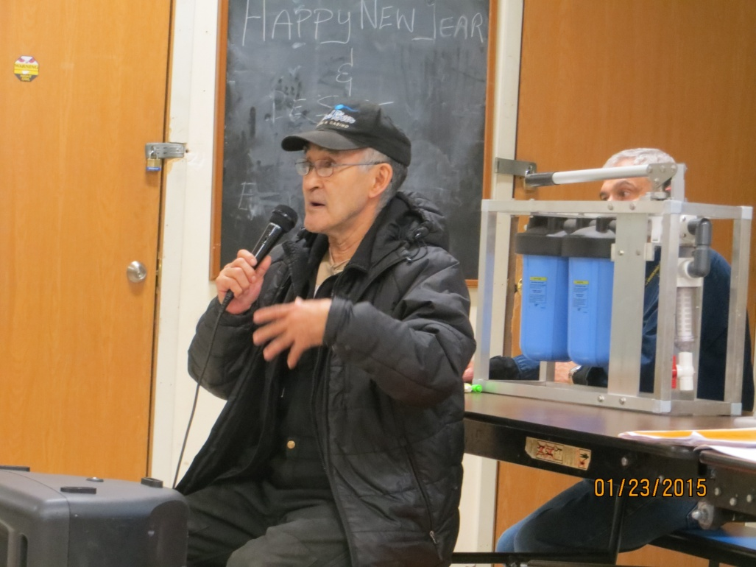
Presenting/Training
Ask one or two respected elders to help present the concepts to the villagers

Slide 38
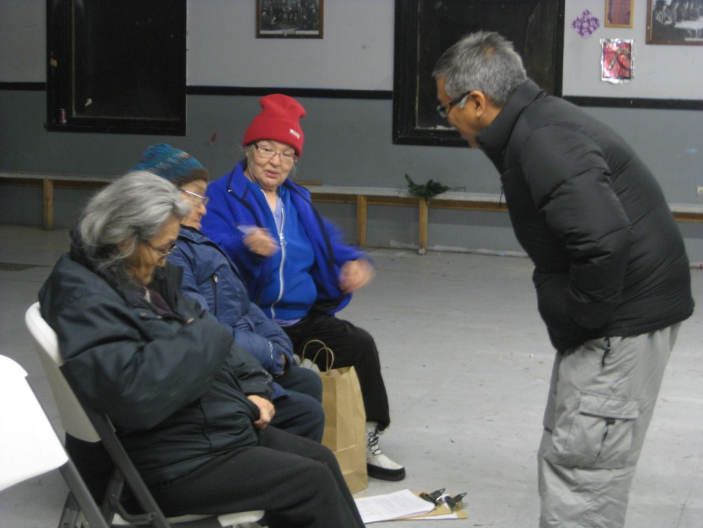
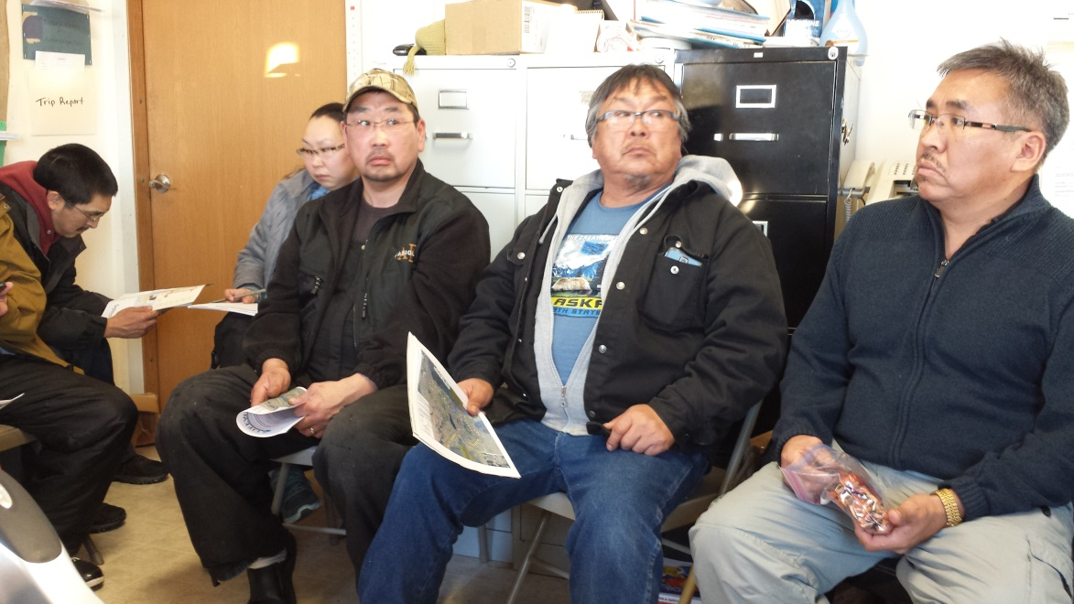
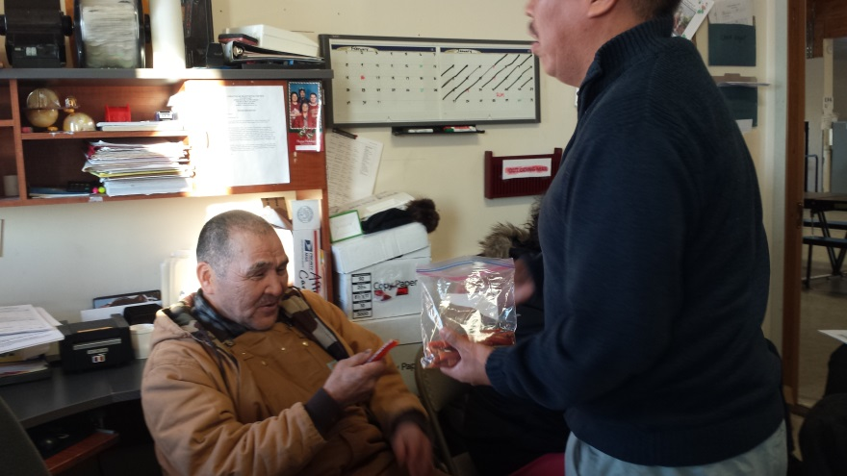
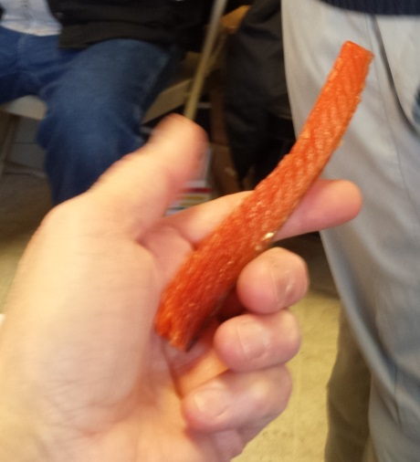
Presenting/Training
Perhaps bring a native person along to do most of the presenting
Follow native protocol

Slide 39
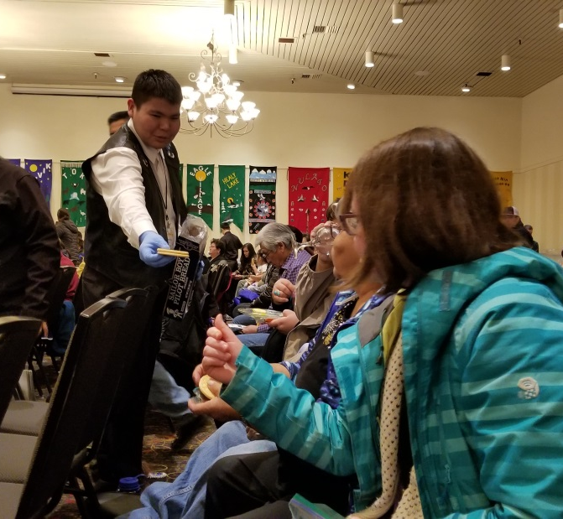
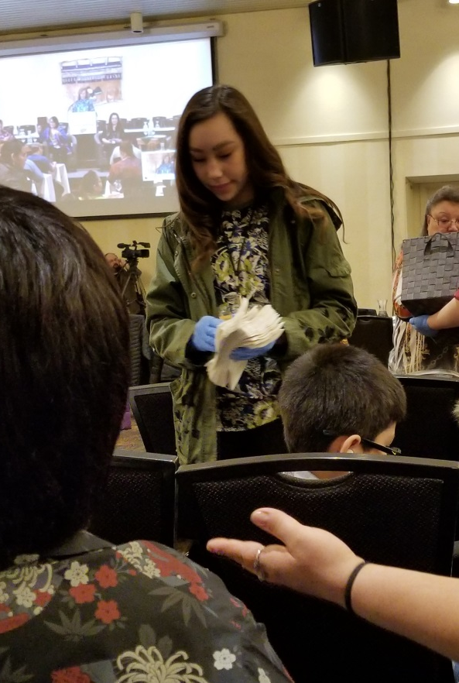
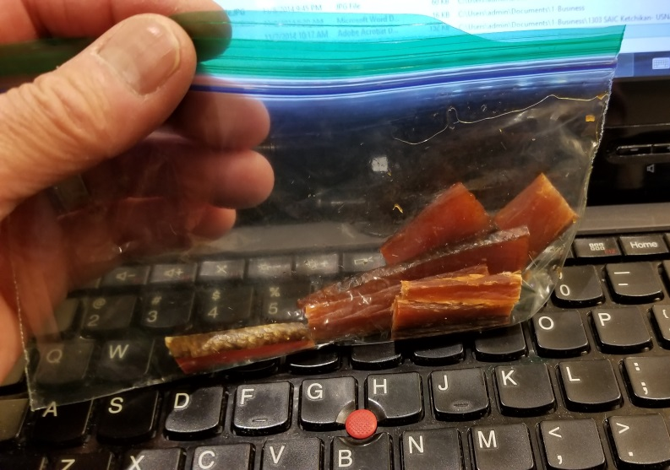
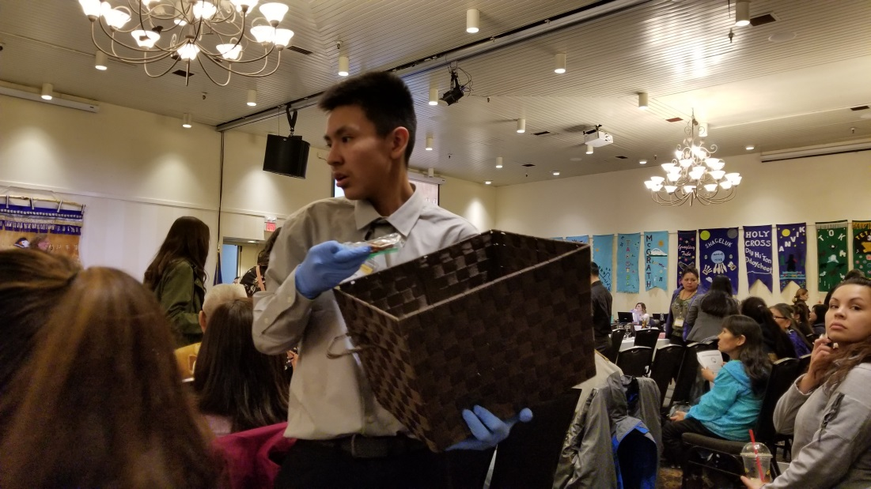
Native protocol at the Tanana Chiefs Conference in Fairbanks

Slide 40
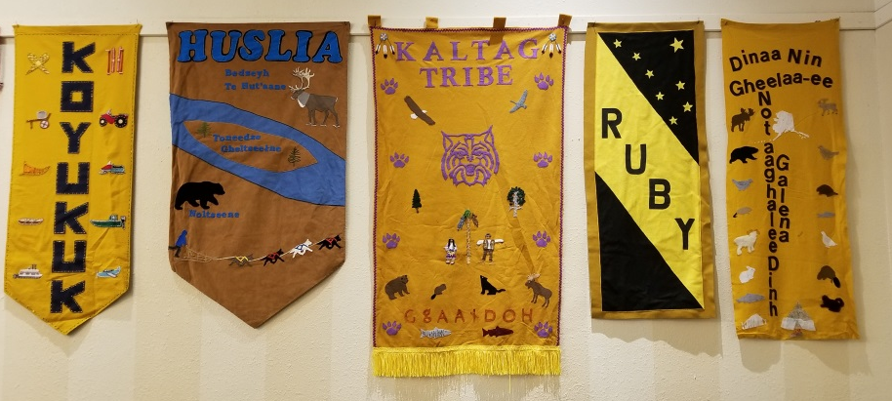
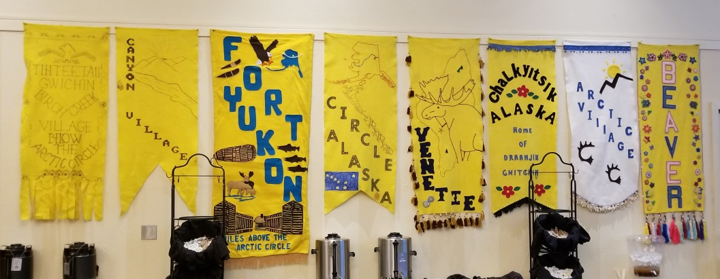
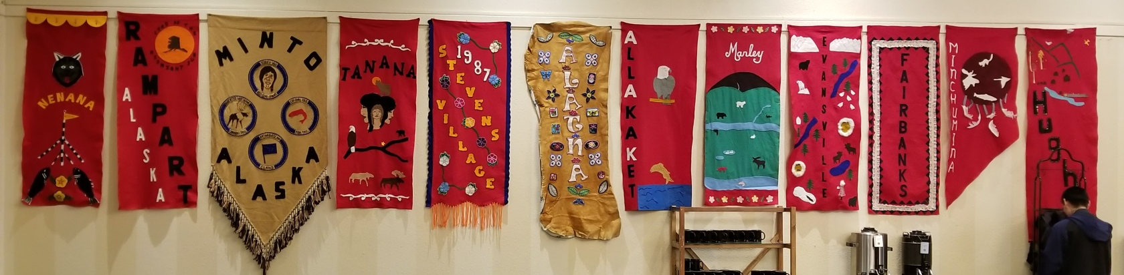
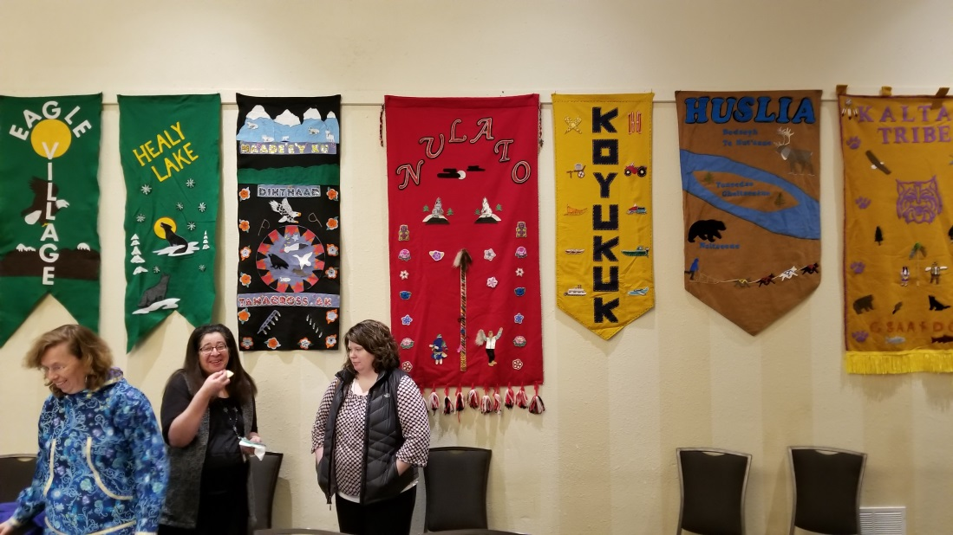
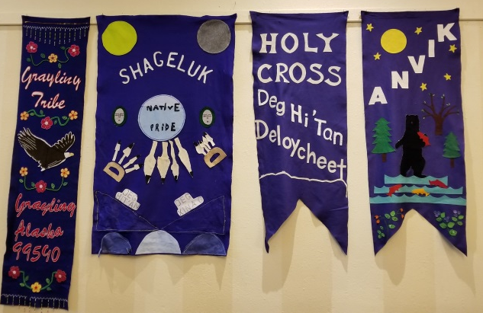
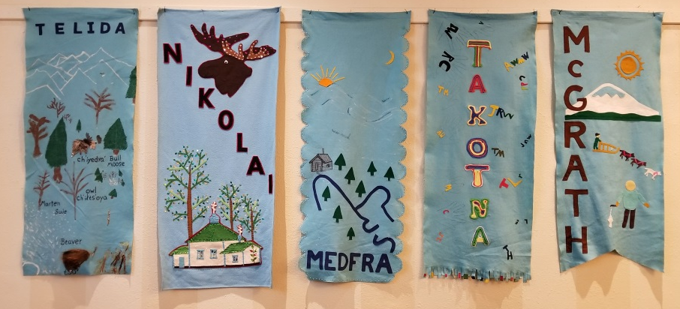
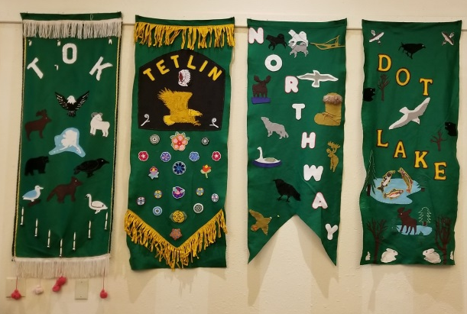

Slide 41
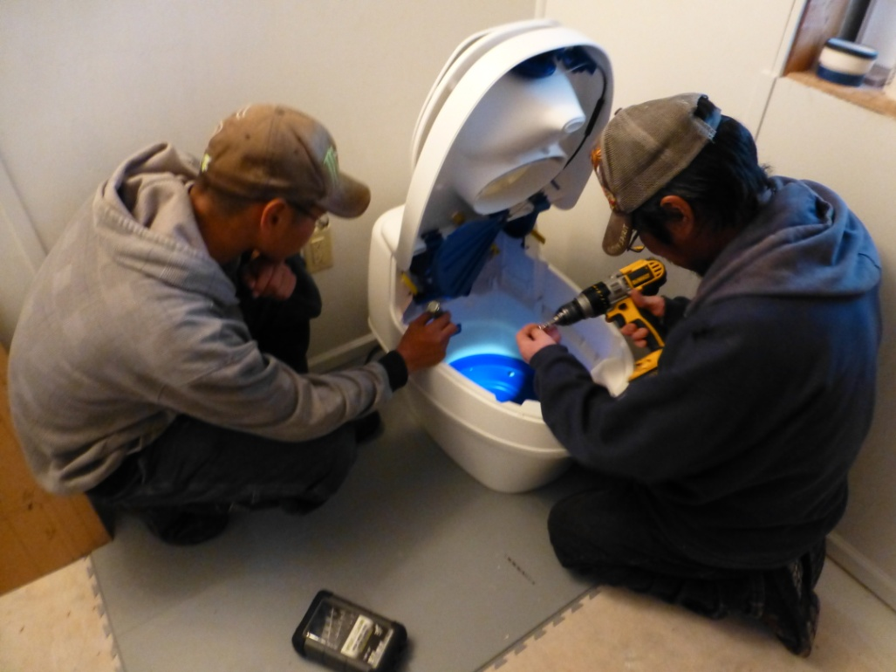
Presenting/Training
Use appropriate training methods
Let them learn by doing, while you guide them to a successful conclusion
Build confidence
Publically acknowledge their newly acquired skills
Give them a certificate of training to place on their wall to honor them and remind them that they are trained

Slide 42
Social Interactions
Silence is acceptable
It is enough to simply enjoy a visitor’s presence
There is not a pressing need for conversation

Slide 43
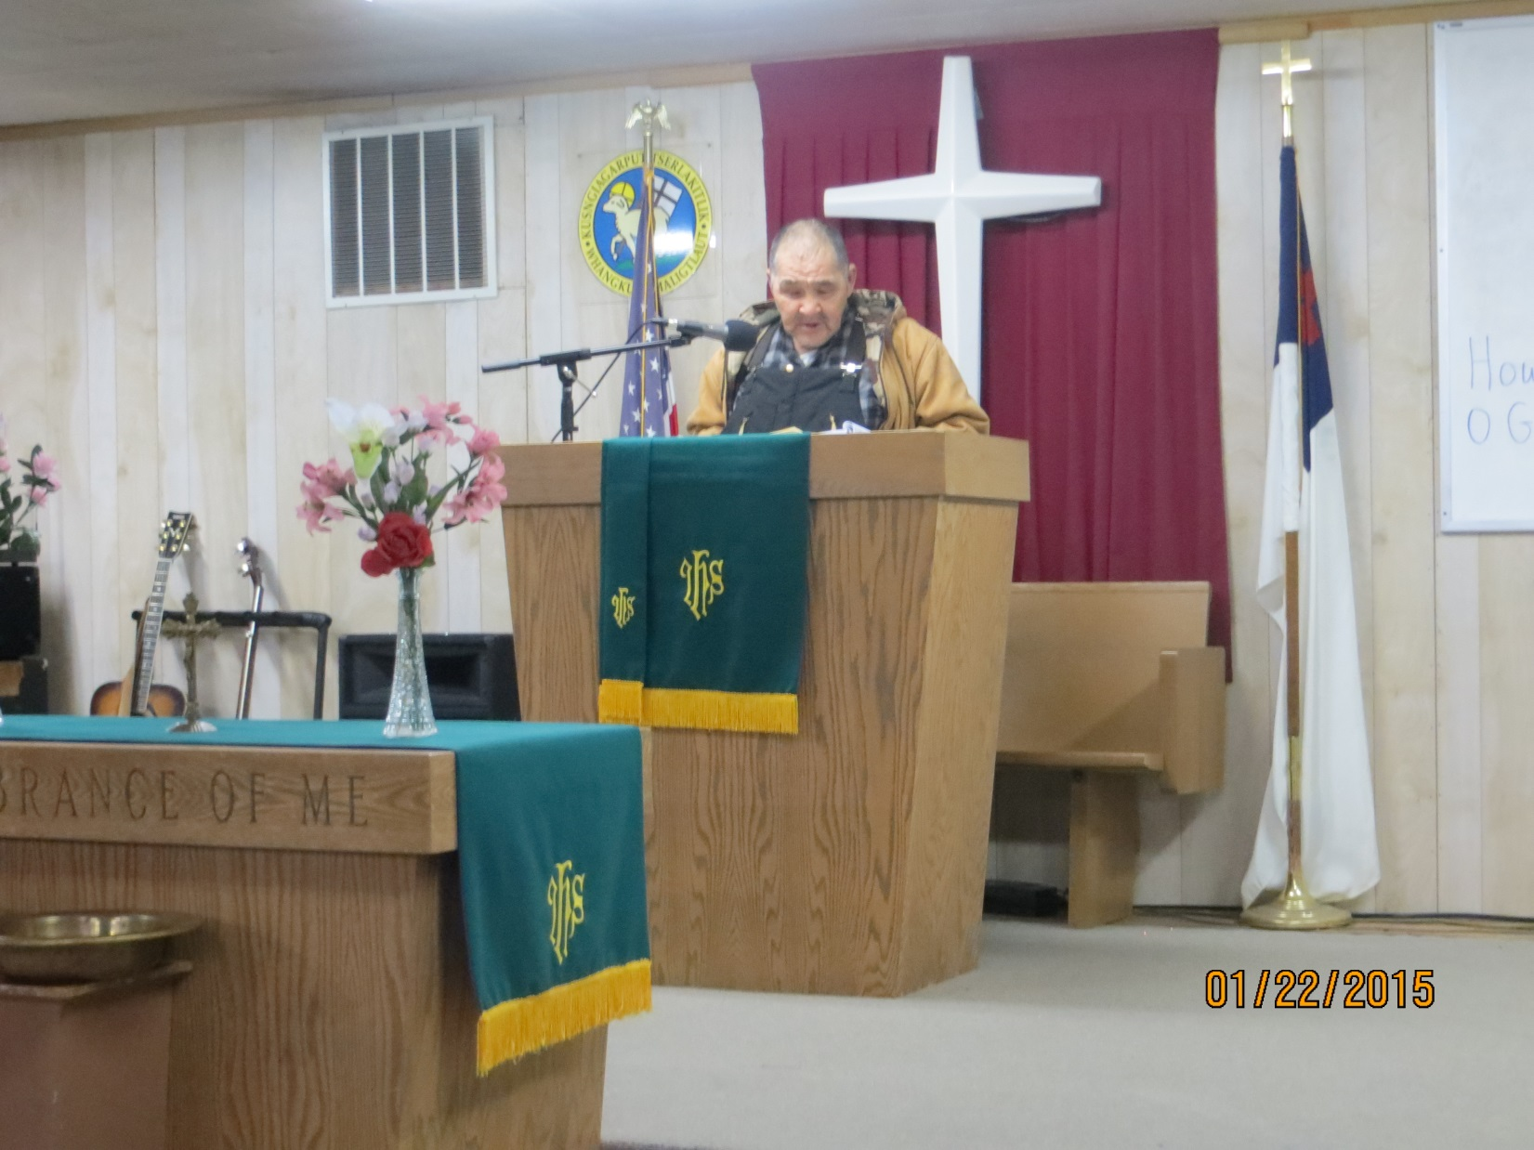
Church service in Atmauluak
(where two elders we’d met led the service)
Get involved!
Notes:
Melvin

Slide 44
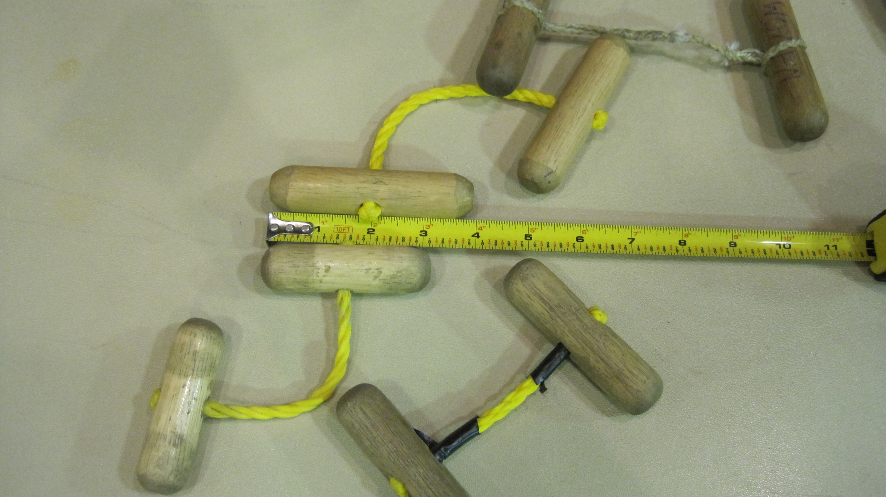
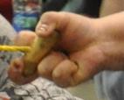
Get involved!
Men’s
size
Women’s
size

Slide 45
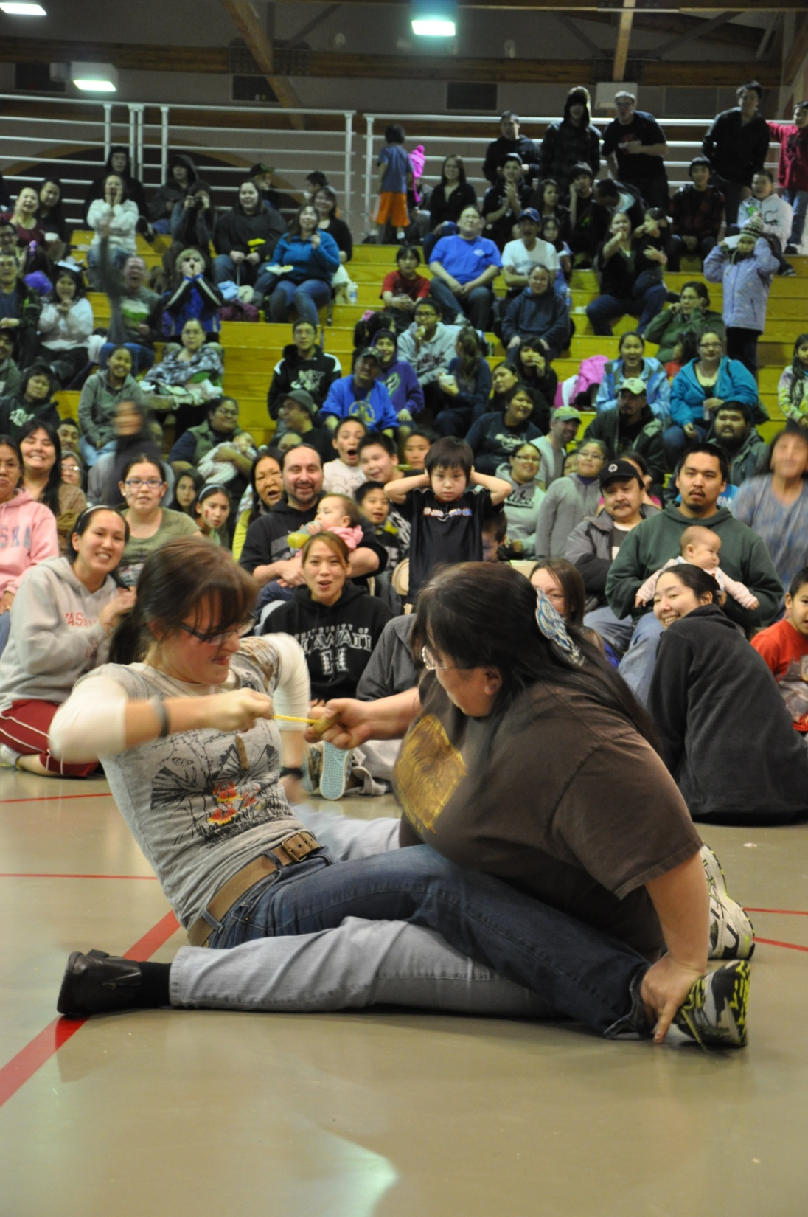
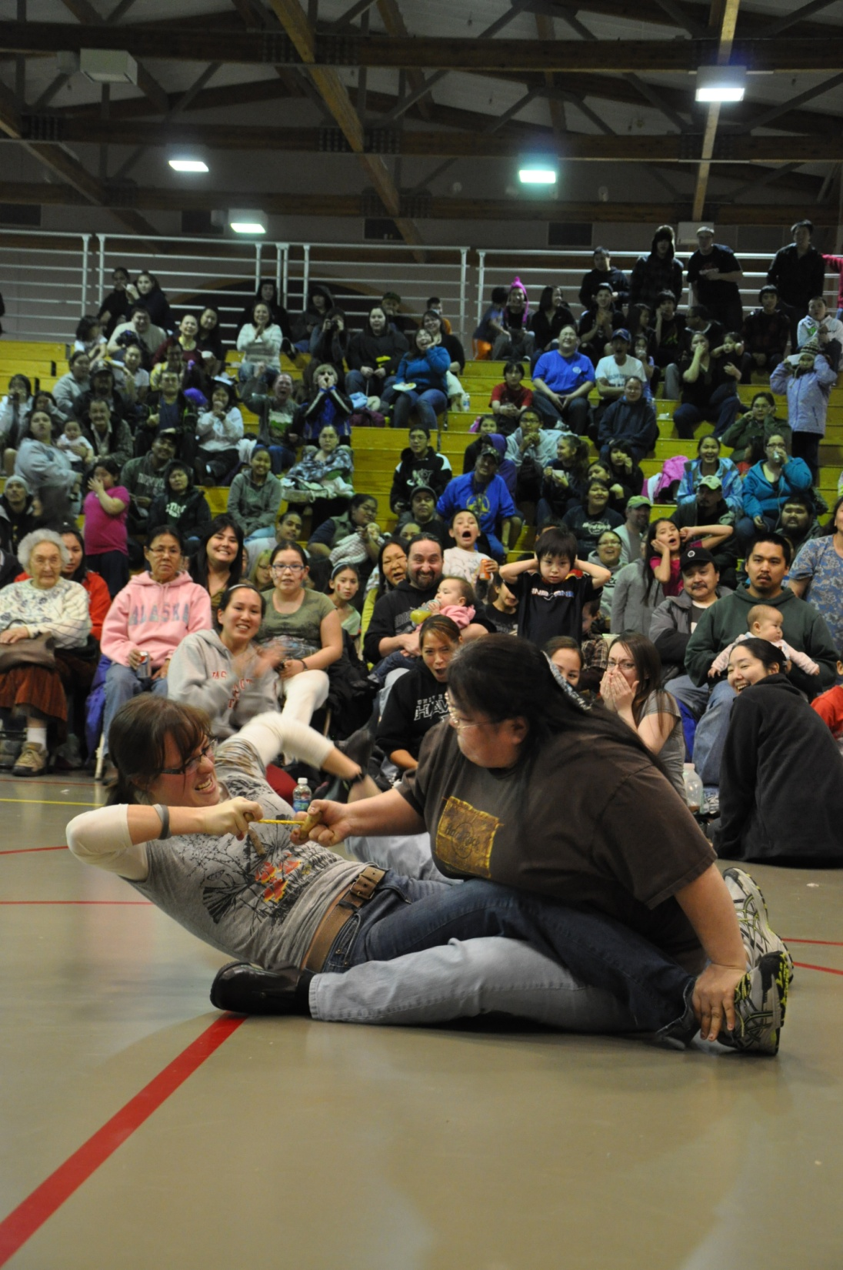
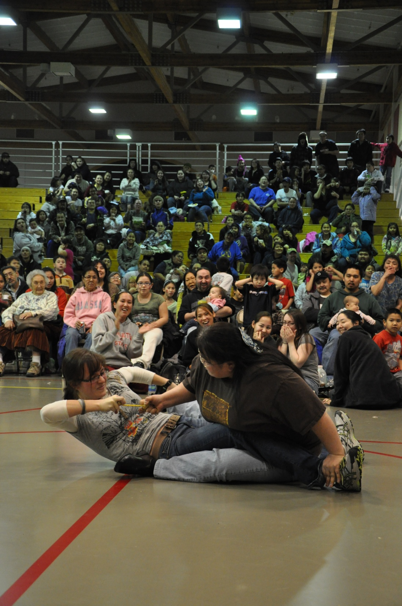
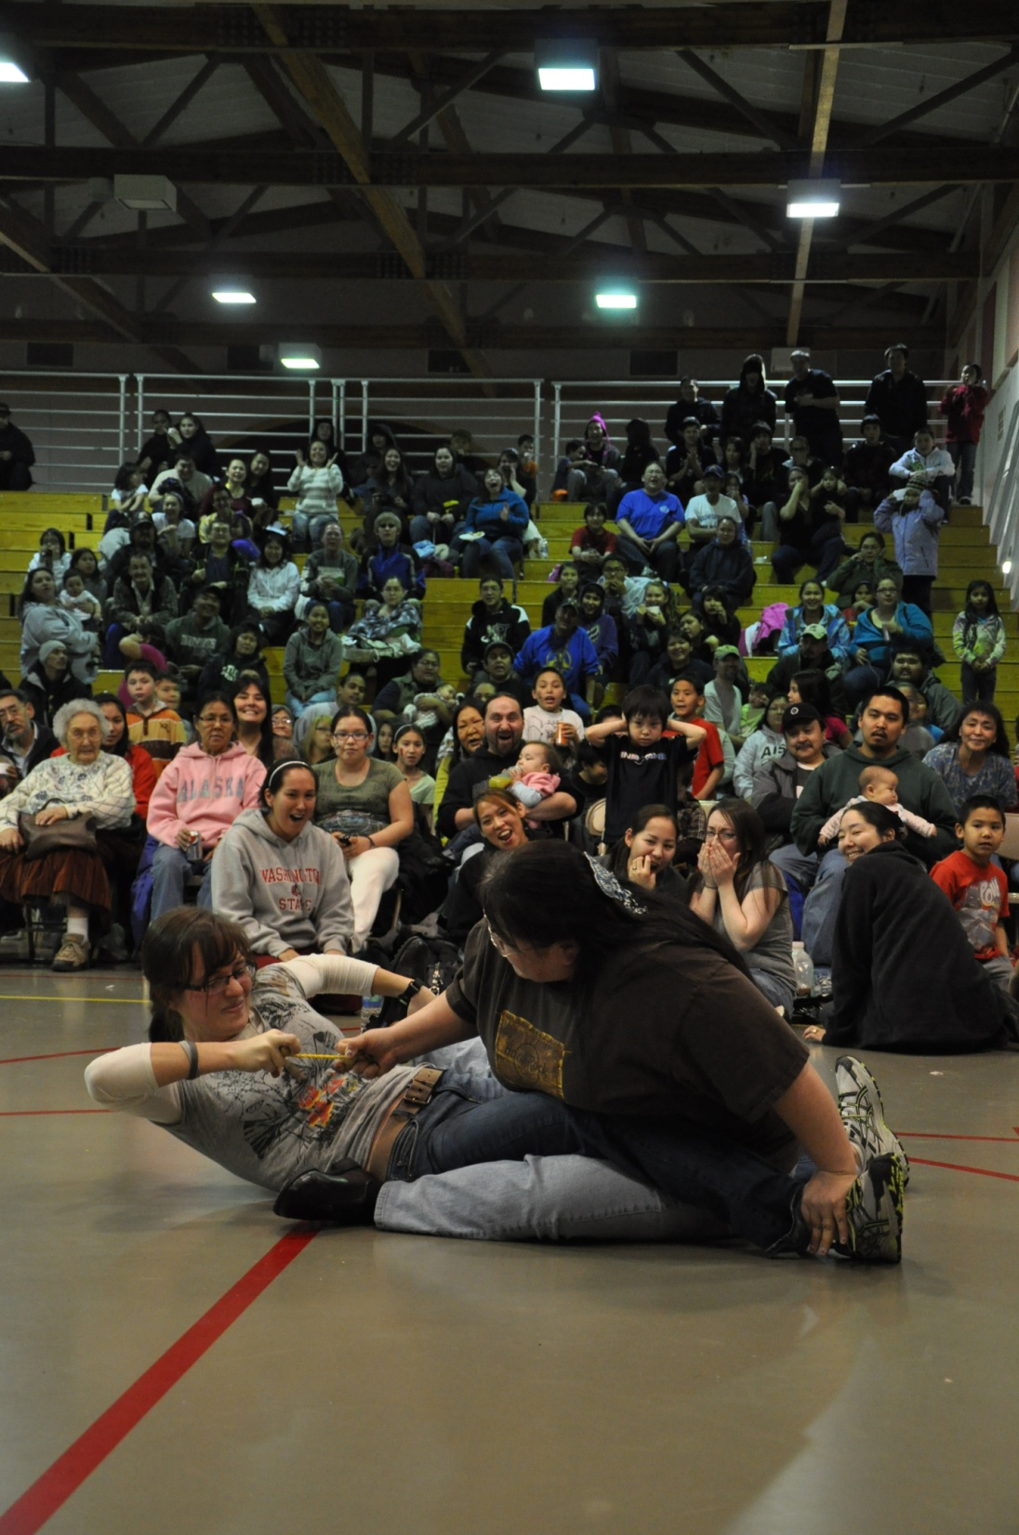
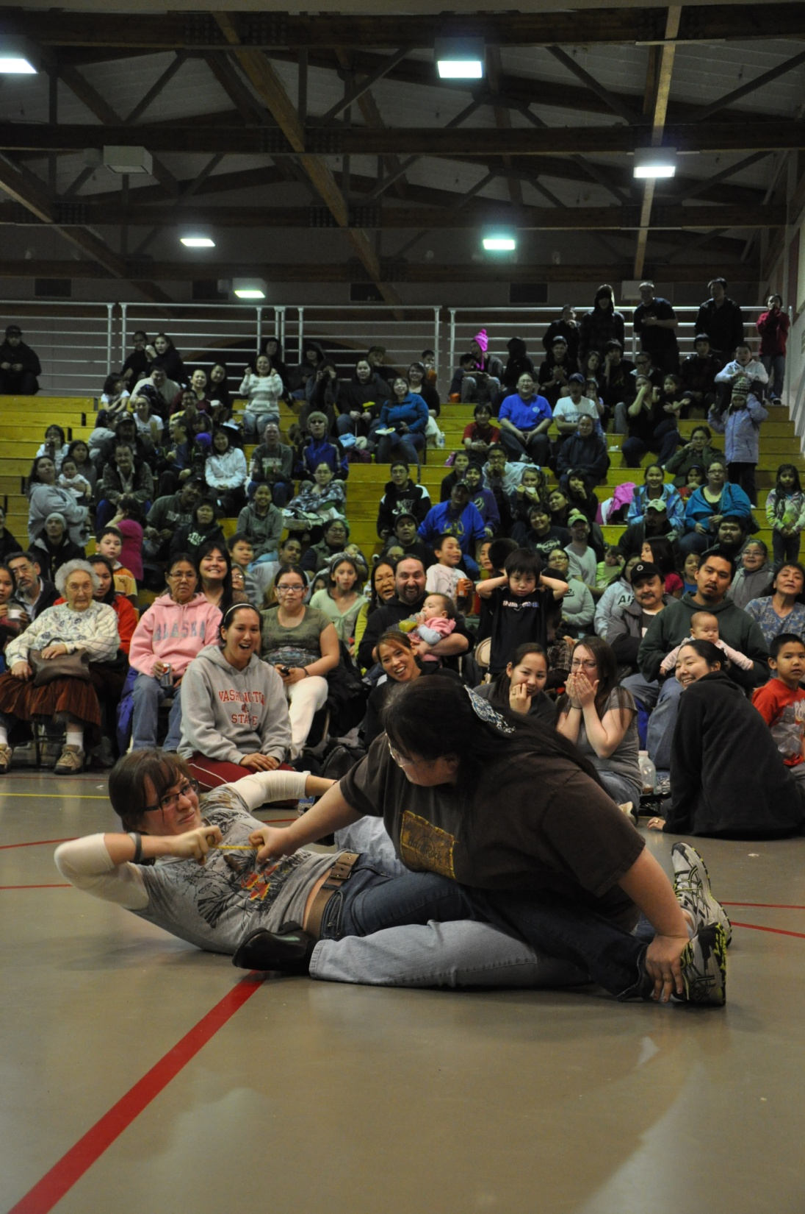
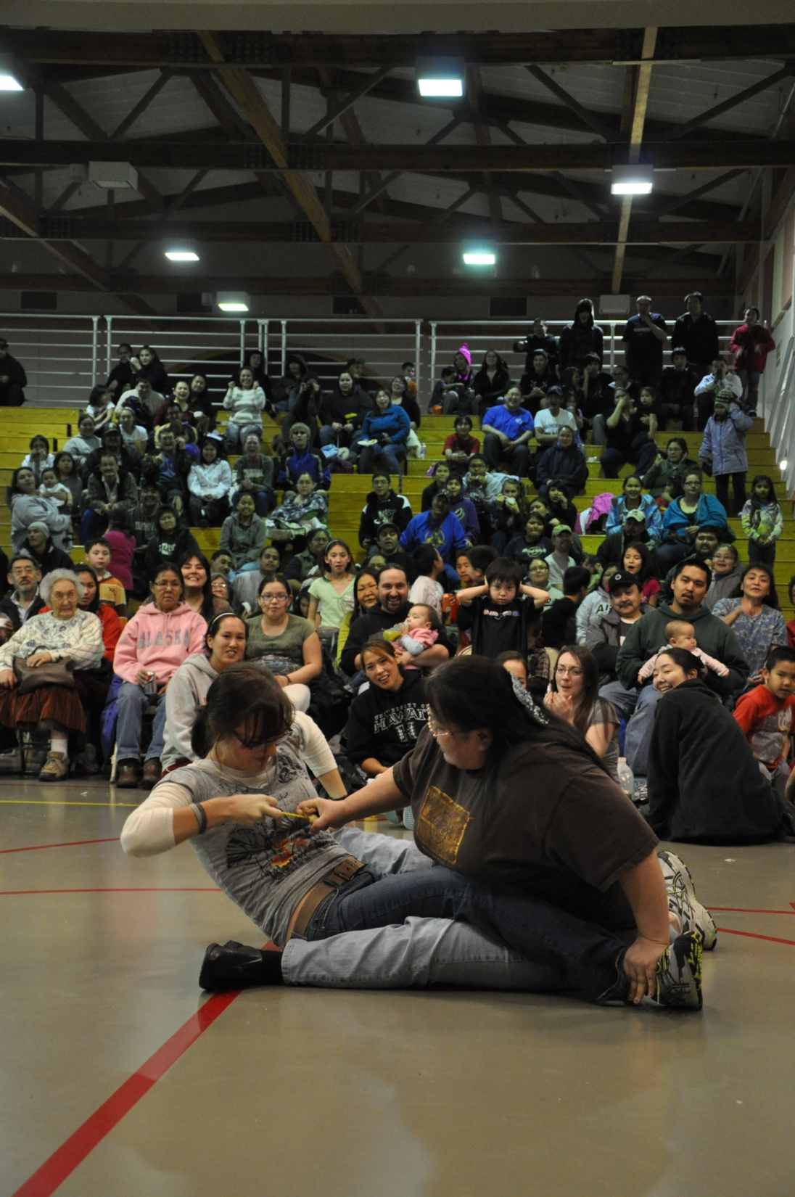
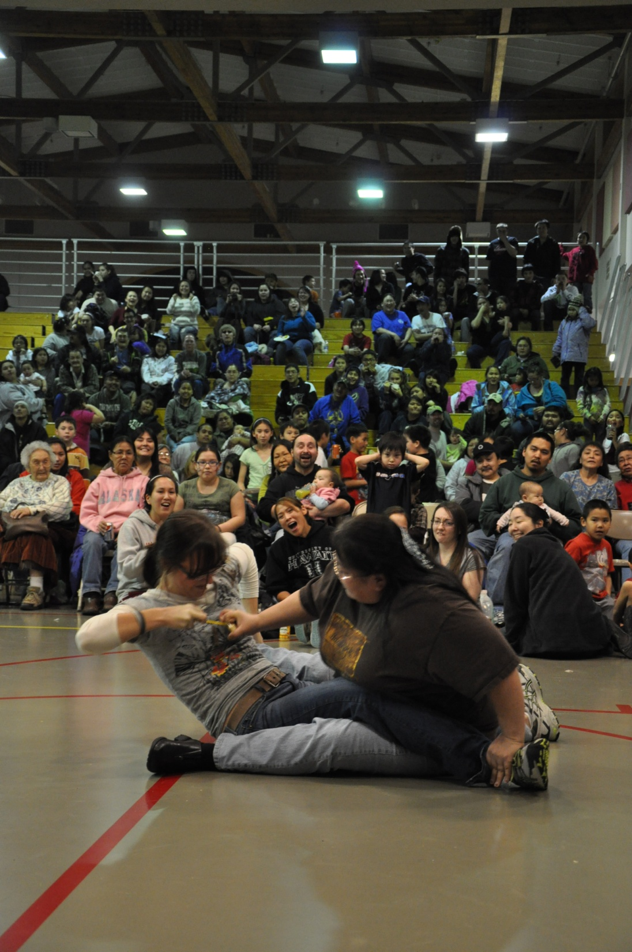
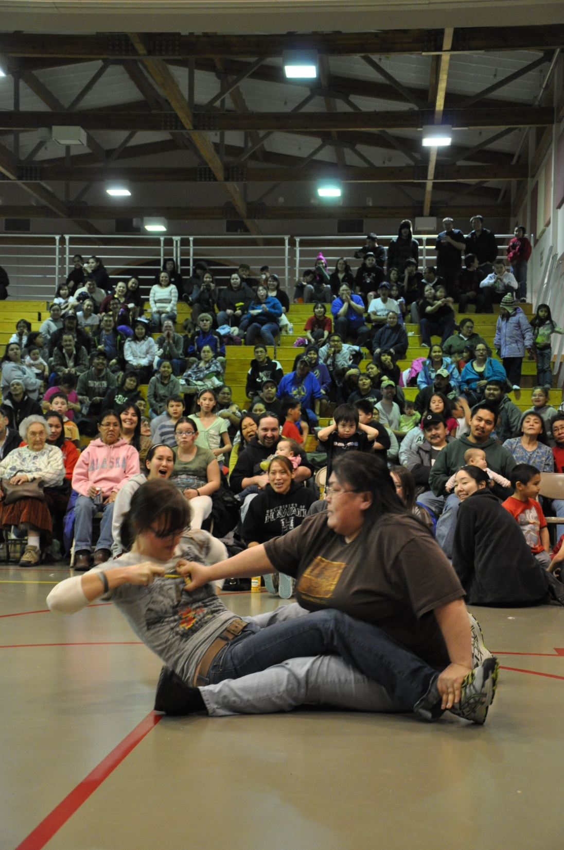
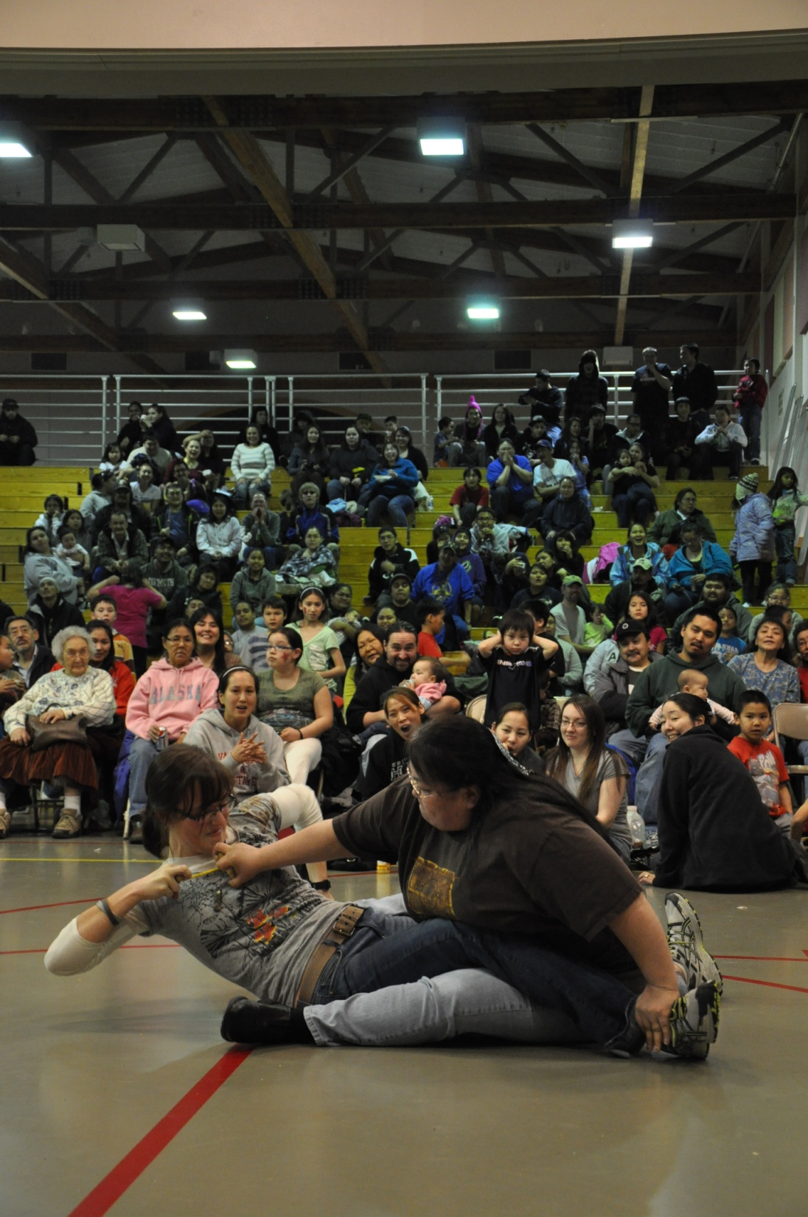
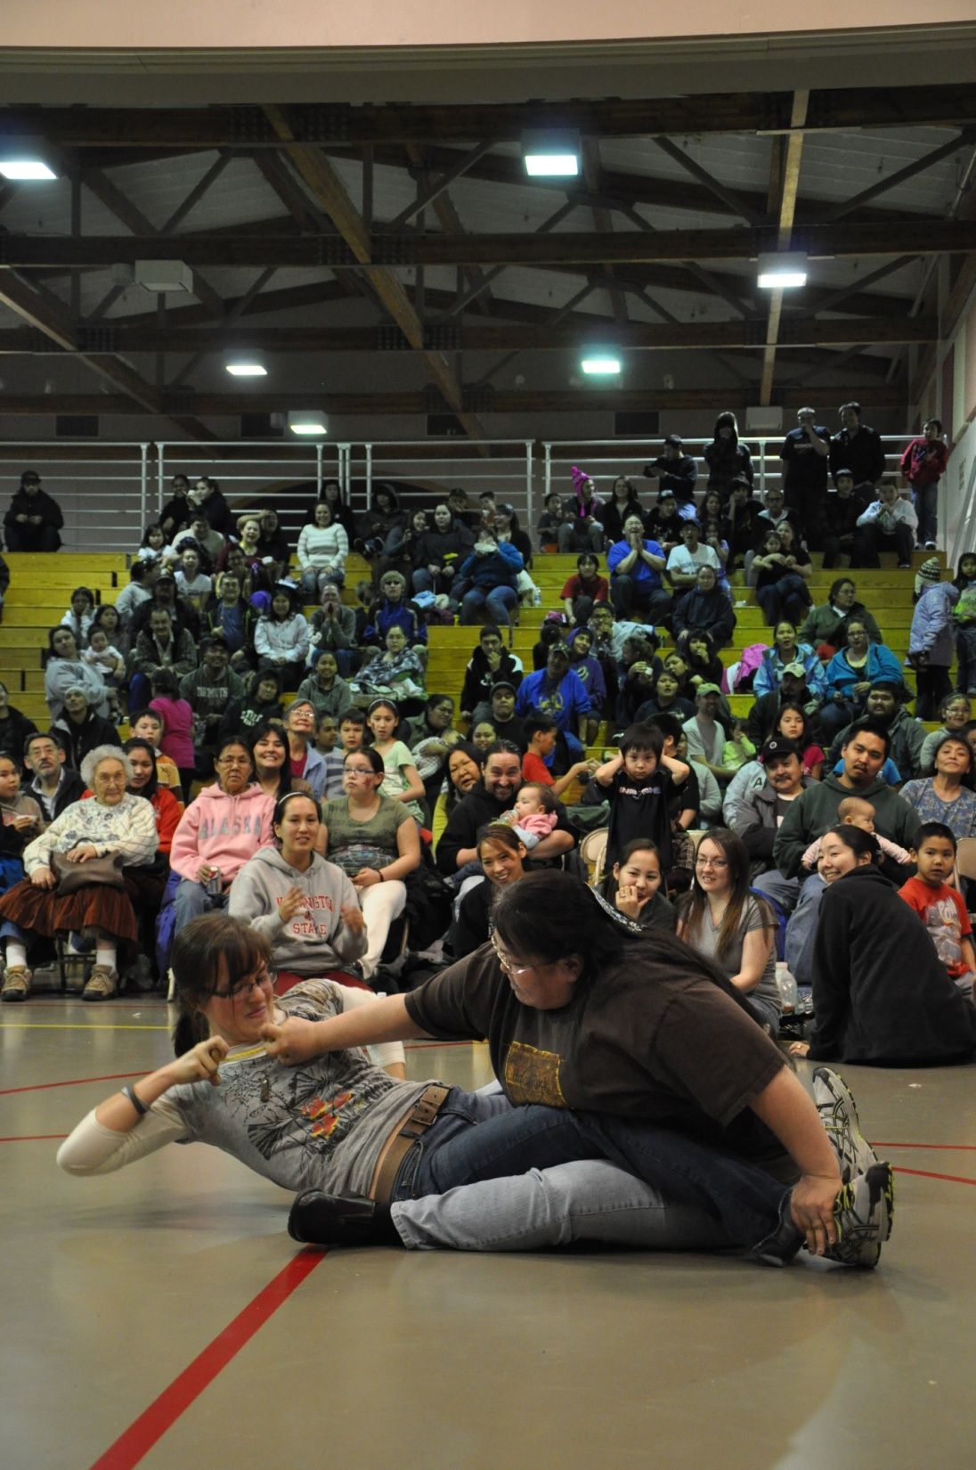
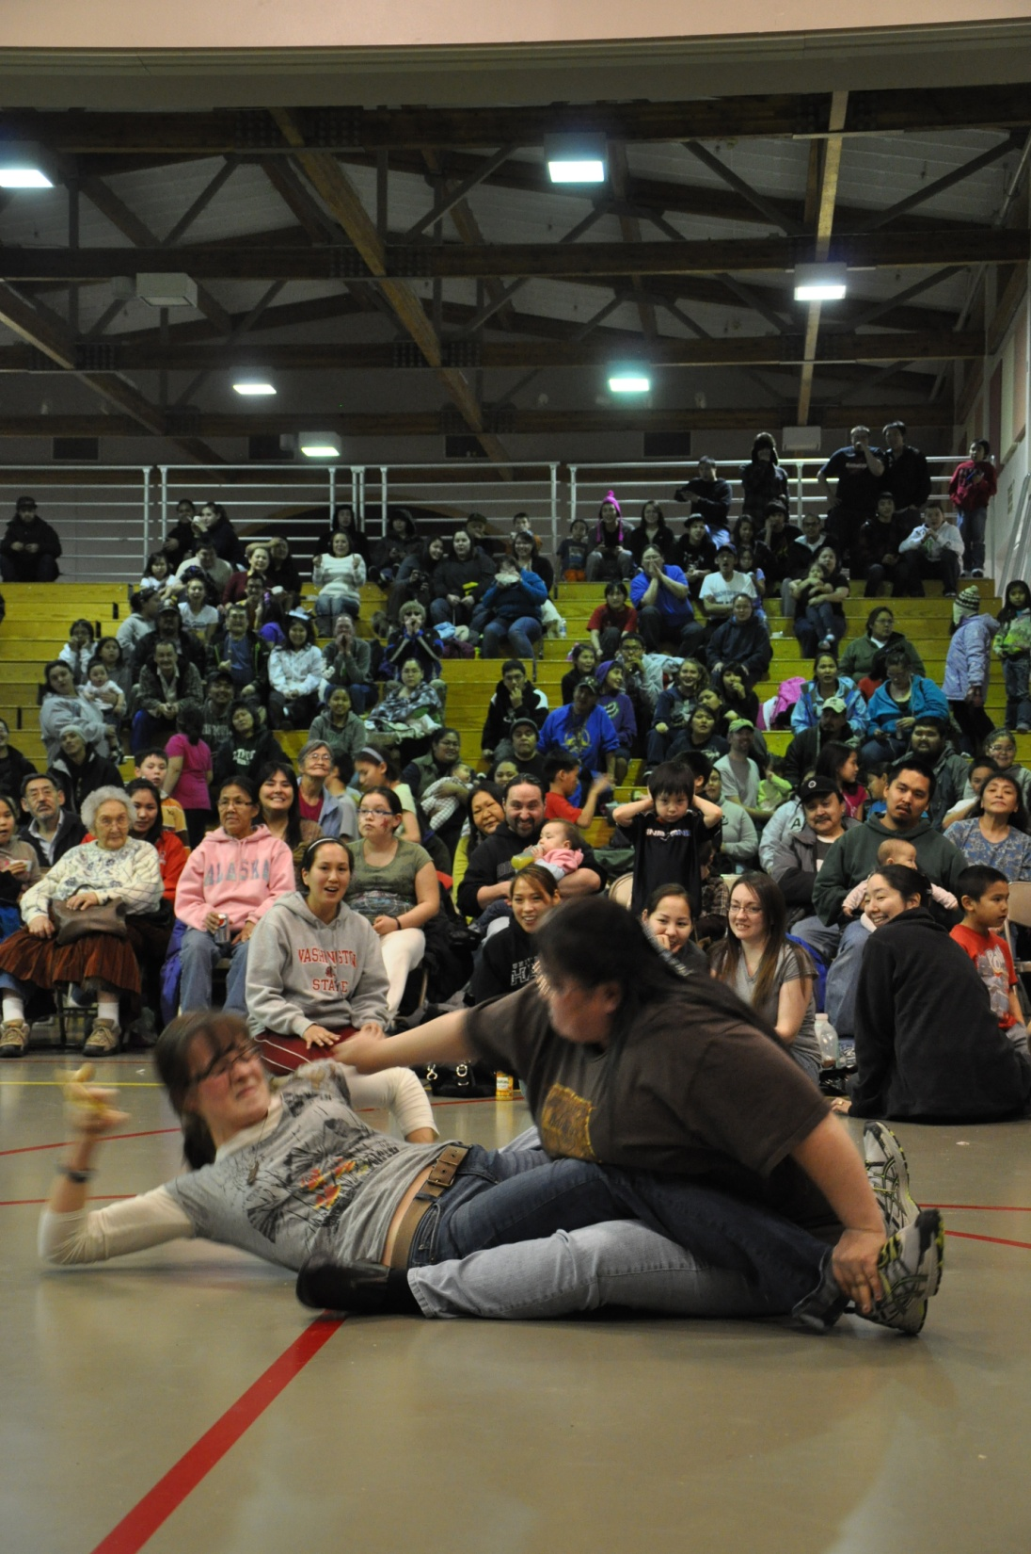

Slide 46
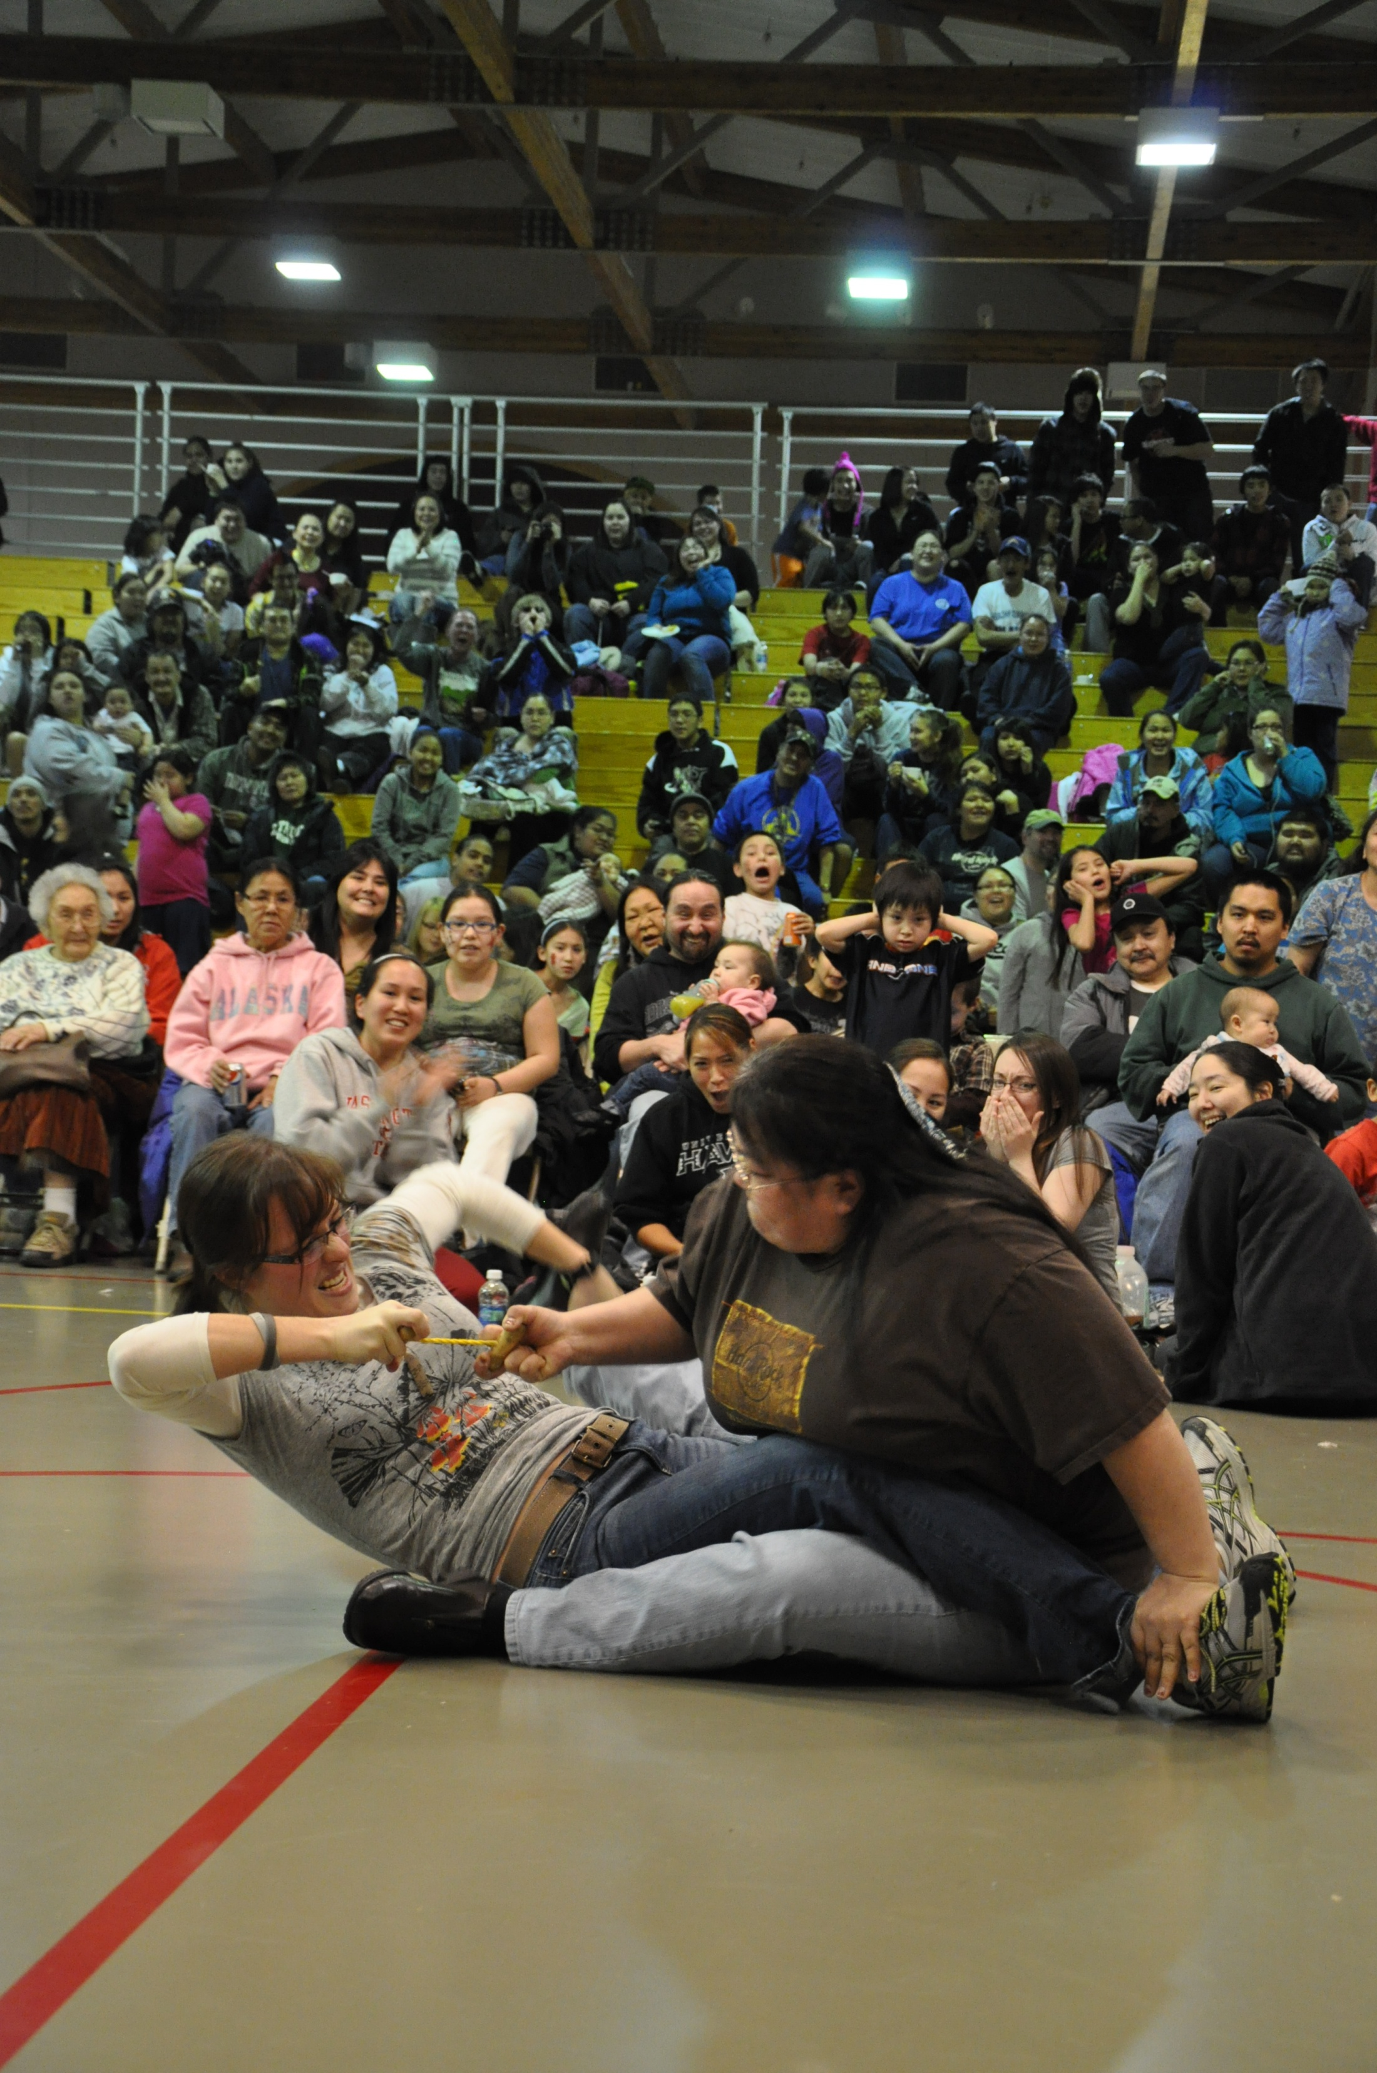

Slide 47
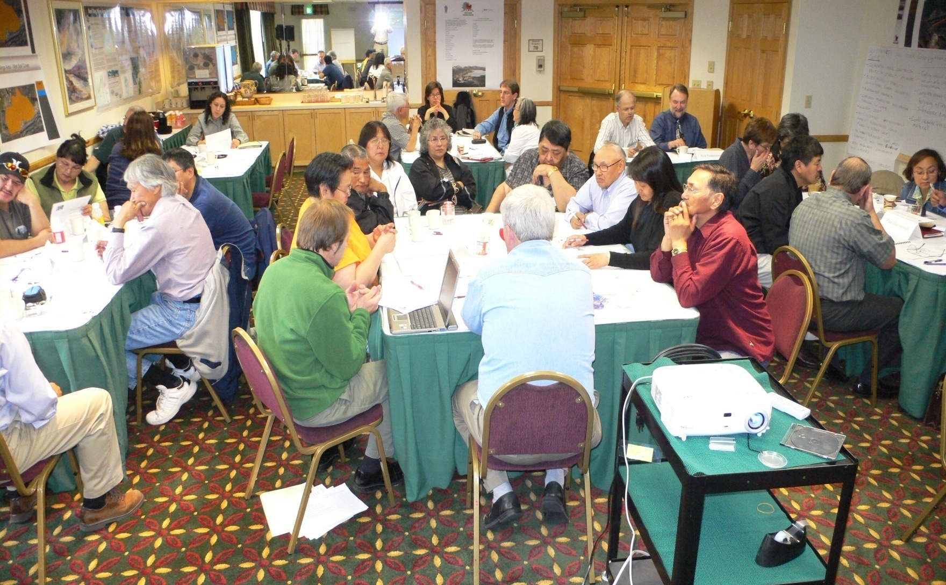
Public Process Example:
Public meeting to develop a reclamation plan for the Red Dog Mine

Slide 48
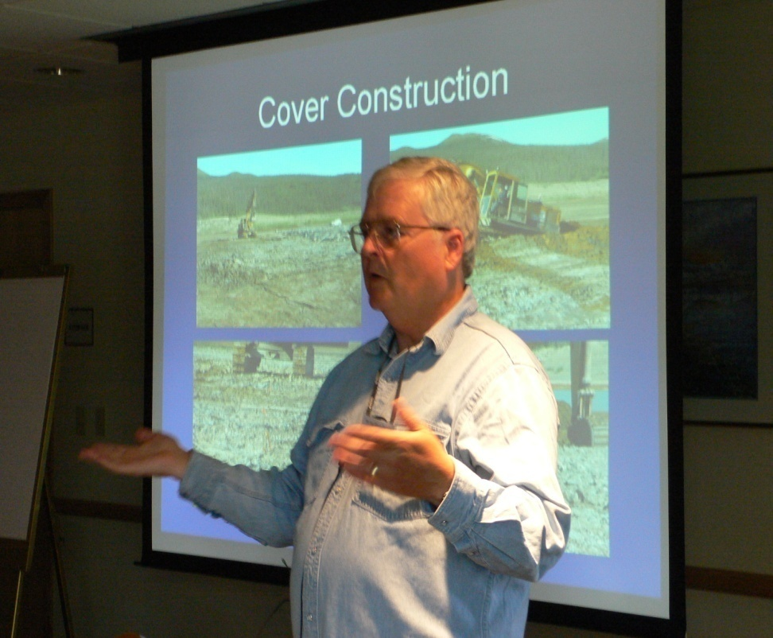
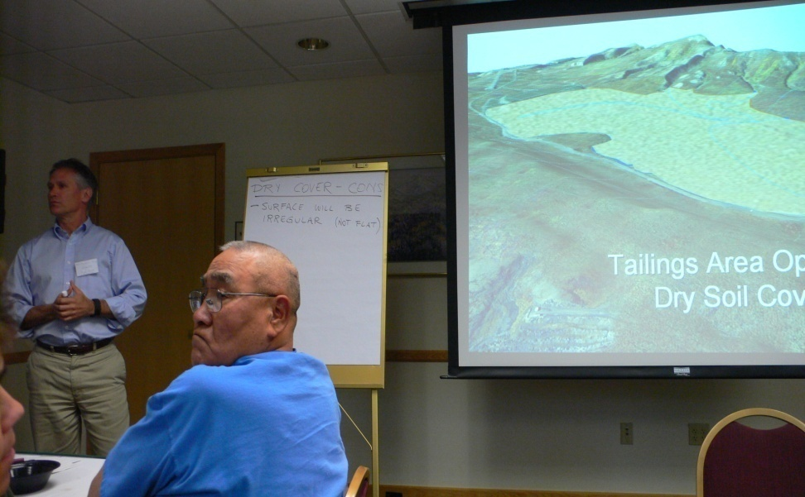
Three alternatives for the tailings pond, and three for the pits & waste rock dumps were presented and discussed for two days

Slide 49
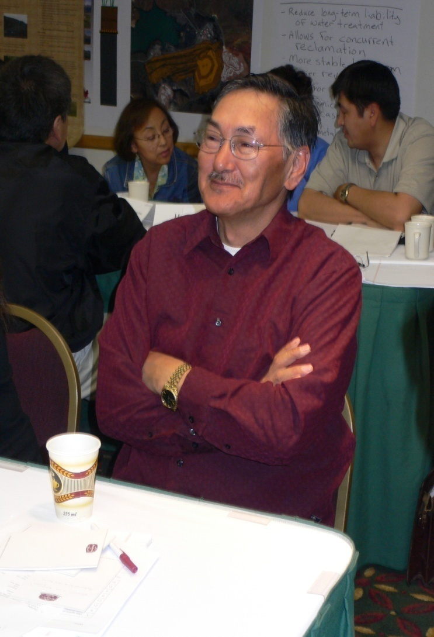
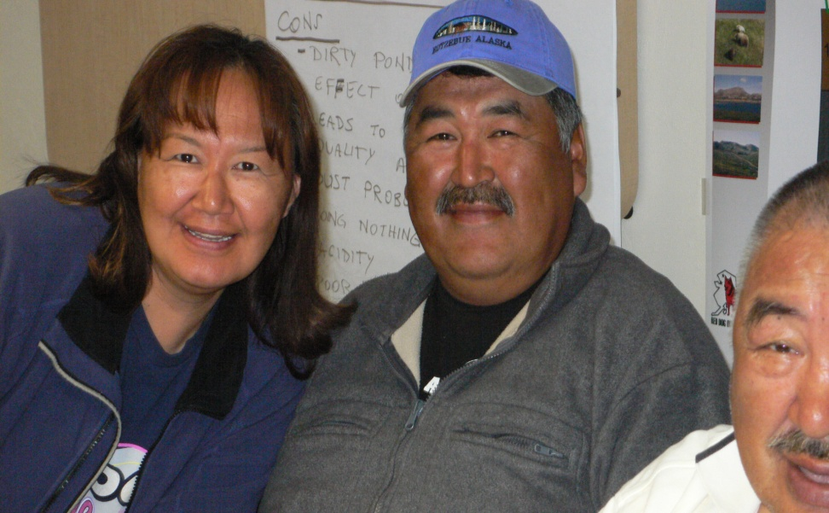

Slide 50
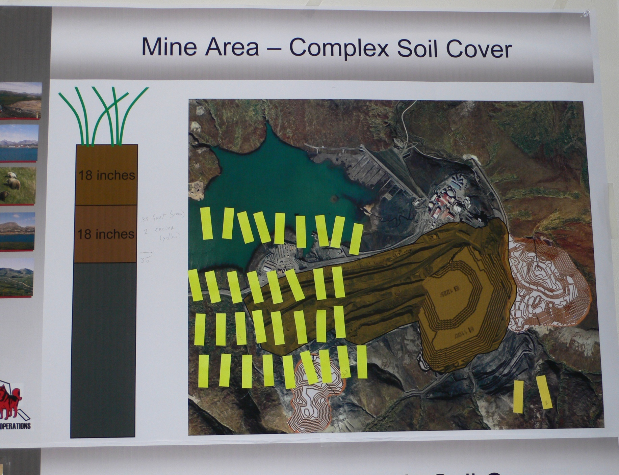

Slide 51


Slide 52
Presenting these decisions to the two communities
Meetings postponed several times
Villagers chose the date (early December), company committed to be there
5 representatives arrived on the selected date

Slide 53
Presenting these decisions to the two communities
Charter flight to Red Dog, then Noatak
Whiteout
Medivac
Props and wings icing up
Skip Red Dog, go straight to Noatak

Slide 54

Whatever it takes…

Slide 55

Village of Noatak – December 2006

Slide 56

Search & Rescue Building

Slide 57

Reminding the villagers of the presentation

Slide 58

“Walter, no one can meet with you today.
We are decorating the church.”
“Me too.”
“I’m confused.”

Slide 59
People came from Fairbanks, Seattle, Spokane, Vancouver, and Toronto on the designated date, yet the meeting was postponed for two more days!
That’s okay!!!!
You must flex!!!!

Slide 60
Problems on a recent exploration project
 | 1996
Shareholder hire rate | 70%
Shareholder supervisors | 10%
Pre-employment failure rate | 90%
Random test failure rate | 55%
Employee turnover rate | 318%

Slide 61
What did they do to solve the problems?
All parties committed to make the program successful. After discussions with elders, village representatives, and past and current employees, decisions were made to:
Provide mandatory cross-cultural training for ALL employees
Maintain open, honest dialogue with villagers and employees
Make frequent trips to meet with villagers

Slide 62
Give applicants and employees the good news and bad news
Enforce a zero tolerance drug & alcohol policy
Provide opportunities to learn
Provide guidance for success
Foster job growth and advancement
Phone workers to remind them to return to work

Slide 63
Change to round dining tables to encourage visiting
Encourage villagers to place family photos in the dining hall
Sometimes include traditional foods
Buy clothing and hand tools from village stores
Support village charities
Demonstrate that YOU CARE about them, their families, their lifestyle, their world and they will become loyal, hardworking, long term employees!

Slide 64
Success on that same exploration project
 | 1996
Shareholder hire rate | 70%
Shareholder supervisors | 10%
Pre-employment failure rate | 90%
Random test failure rate | 55%
Employee turnover rate | 318%
2005
92%
92%
5%
5%
10%

Slide 65
Healthy, respectful cross-cultural interactions are very important to your success, not just in the North but everywhere, always!

